Slide 1




Meet the Teacher!
Year 2 – Owl Class

Slide 2
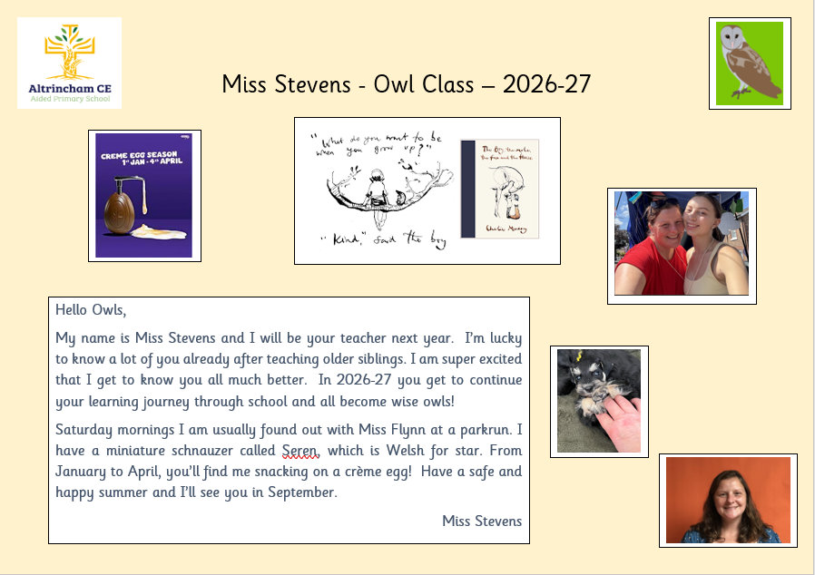
Meet the Teacher!

Slide 3

Curriculum - English
English is taught through sessions organised into writing, whole class guided reading, punctuation and grammar, handwriting and spelling.
How you can support your child at home.
Reading is the master skill
Whether that is listening to your child read their school home reading book, sharing a book together or independent reading time, encouraging daily reading is the best way to support your child.
Spellings – support your child by learning the statutory spellings words for Year 2.

Slide 4


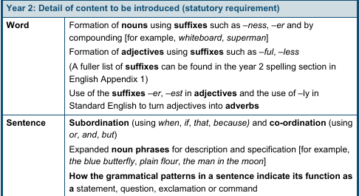
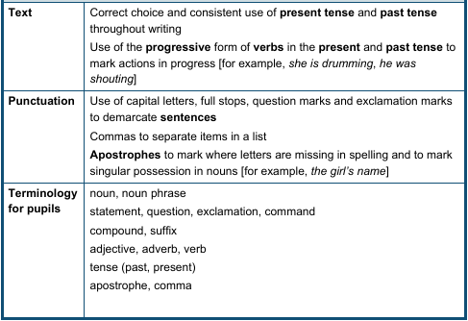
Curriculum - English
Whole Class Guided Reading | Spelling | Punctuation & Grammar

Slide 5






Curriculum - Writing
Autumn 1 Troll Swap by Leigh Hodgkinson Write a character story. | Autumn 2 The Owl who was Afraid of the Dark by Jill Tomlinson Write a non chronological report (fact sheet). | Spring 1 The Dragon Machine by Helen Ward Write an adventure story.
Spring 2 My name is not Refugee by Kate Milner Write a recount – diary. | Summer 1 The Last Wolf by Mini Grey Write a persuasive Letter. | Summer 2 Grandad’s Secret Giant by David Litchfield Write a story with a moral focus.

Slide 6

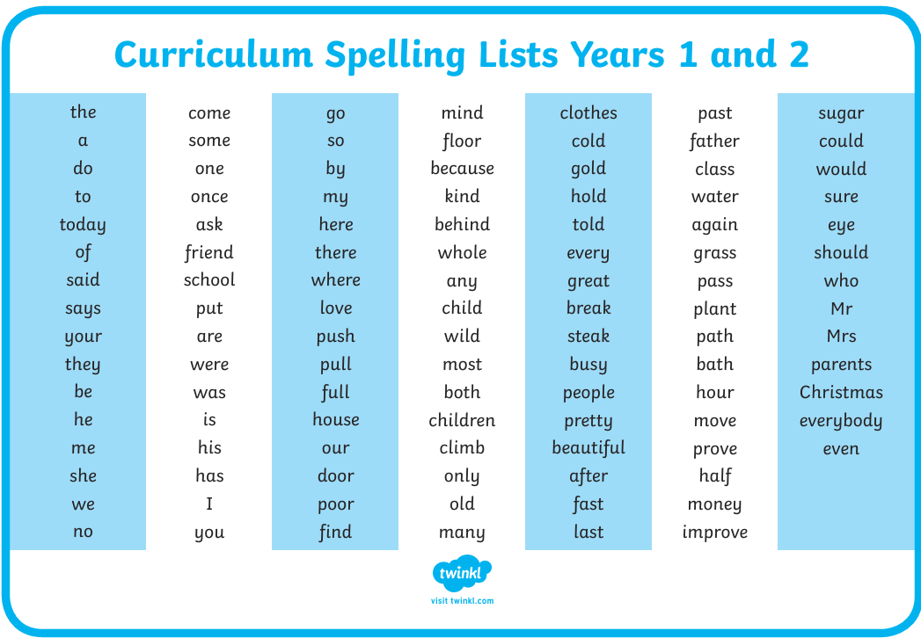
Curriculum - Spellings

Slide 7

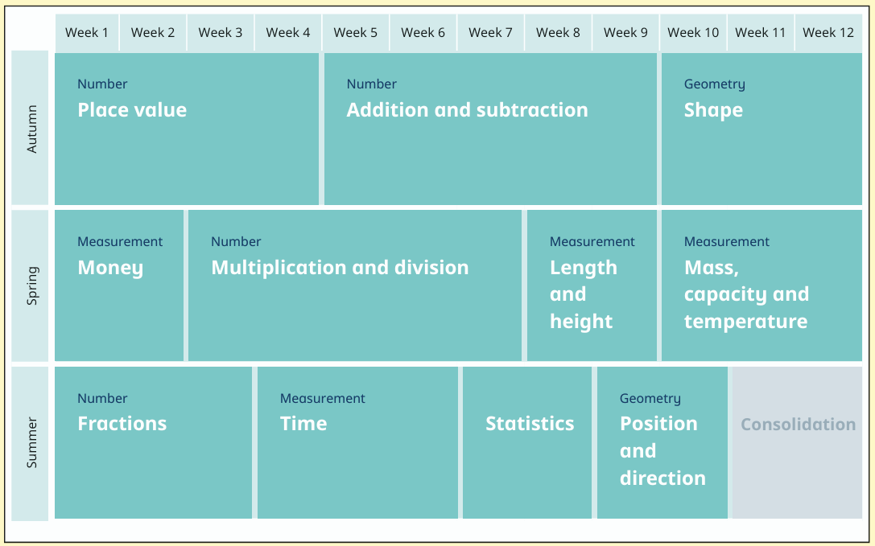
Curriculum-Maths
We follow the White Rose Scheme.
How you can support your child at home.
Log on to MyMaths and complete the weekly activities set. The activities are aligned with the WRM scheme and consolidate the weeks learning.

Slide 8
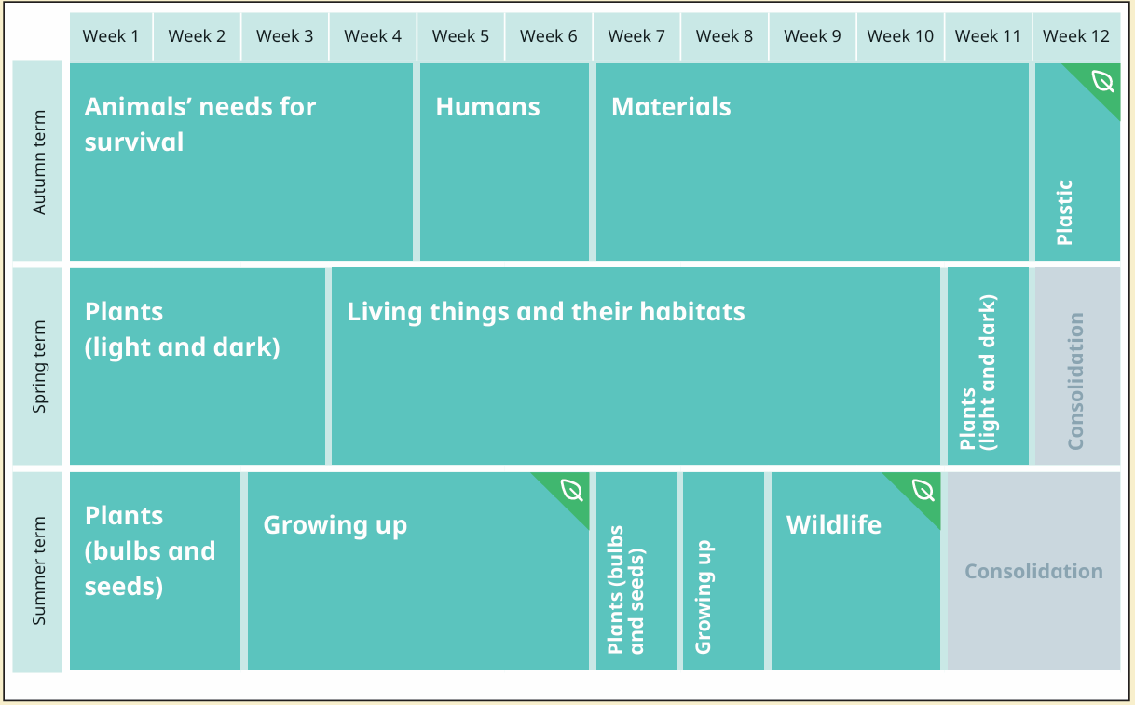
Curriculum Overview
Science -
White Rose

Slide 9
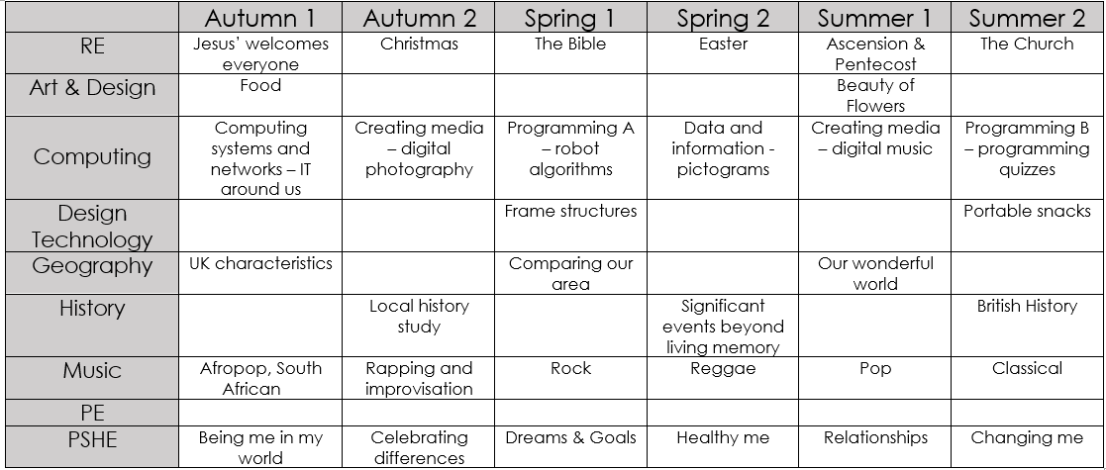
Curriculum Overview
Wider Curriculum

Slide 10

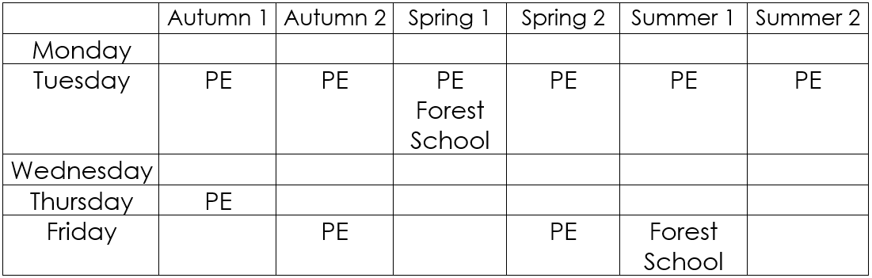
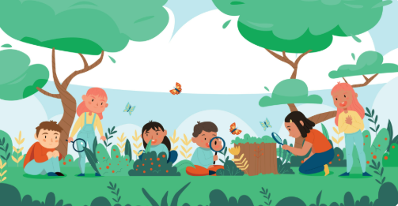
PE and Forest School Timetable

Slide 11

Home Learning
Daily exposure to reading – independent, school reading scheme or shared reading.
Weekly MyMaths activity.
Opportunities to learn to spell words from the Year 2 spelling list.

Slide 12

Any Questions?

