Slide 1

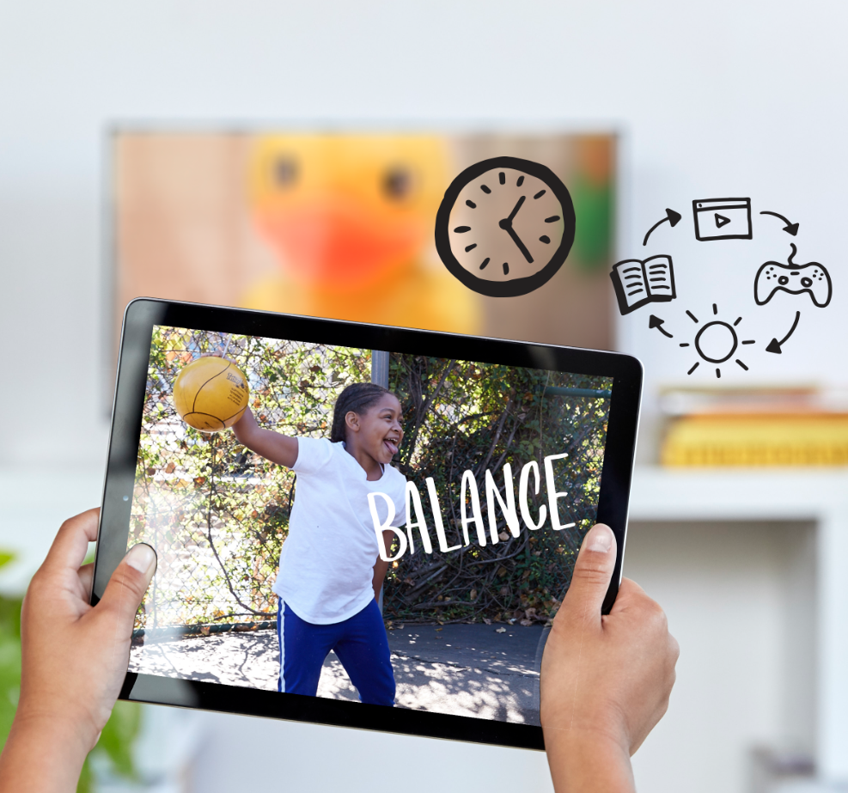
DIGITAL CITIZENSHIP | GRADE 4
My Media Choices

Slide 2

Essential Question
What makes a healthy media choice?

Slide 3

Learning Objectives
l
Learn the What? When? How Much? framework for describing different media choices.
Use this framework and their emotional responses to evaluate how healthy different types of media choices are.
Begin to develop their own definition of a healthy media balance.
2
3

Slide 4

WARM UP: THINK, PAIR, SHARE
What do you think the word "media" means? What are
some examples?
Directions:
Take a moment to think silently about the question.
Then, take turns sharing your response with your partner.

Slide 5


KEY VOCABULARY
Media
All the ways that large groups of people get and share information (TV, books, the internet, newspapers, phones, etc.)

Slide 6
KEY VOCABULARY
Media Choices
Time spent watching, listening to, reading,
or creating media

Slide 7
WARM UP: THINK-PAIR-SHARE
Directions:
Look at the following six slides. Each one has a "media choice" that someone else has made.
As you see each slide, think about how this media choice would make you feel, if it were a choice you had made.
Share your thoughts! Raise your hand and wait for your teacher to call on you.

Slide 8

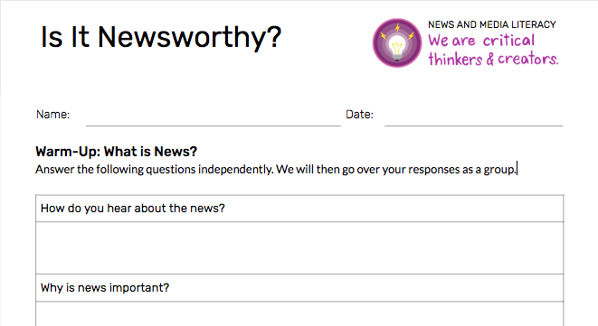

What? | When? | How Much?
I watched YouTube cat videos on my mom’s iPhone. | Monday morning, before school | For about 20 minutes

Slide 9
What? | When? | How Much?
I watched Trollhunters on Netflix (on my iPad). | Late on Wednesday night, in bed, until I fell asleep | For two and a half hours

Slide 10
What? | When? | How Much?
I played an online game (Fortnite) on my parents’ computer. | On Saturday, pretty much all day | Probably about six hours

Slide 11
What? | When? | How Much?
I talked to my grandma on FaceTime (on my dad’s iPhone). | Tuesday evening, right before dinner | For about 10 minutes

Slide 12
What? | When? | How Much?
I went on TikTok and created some cool videos to send to my friends. | Thursday afternoon, after school | For about 45 minutes

Slide 13
What? | When? | How Much?
I read a book that I’m really into right now (Wonder). | Tuesday evening, after dinner | For about an hour

Slide 14
What makes a healthy media choice?
What?
When?
How much?
What are the media you're consuming (or creating)?
What platforms are you using to consume the media (i.e., a streaming platform like Netflix)?
or …
What device(s) are you using to consume (or create) the media?
When are you consuming (or creating) the media?
What time of day? What day of the week?
What else is happening at this time (i.e., is it during dinner time, right before bed, etc.)?
How much media are you consuming?
How long are you spending with the media at one time?
How often are you consuming the media?

Slide 15

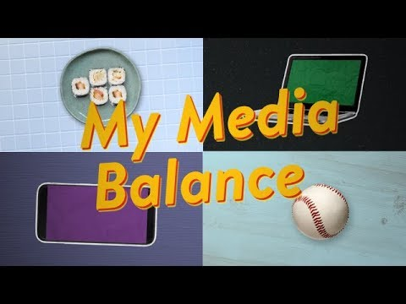
WATCH + DISCUSS
Discuss:
How are some media choices more healthy or less healthy than others?
What is "media balance"? How might it be different for different people?
To watch this video on the Common Sense Education site, click here.

Slide 16
KEY VOCABULARY
Media Balance
Using media in a way that feels healthy and in balance with other life activities (family, friends, school, hobbies, etc.)

Slide 17


