Slide 1


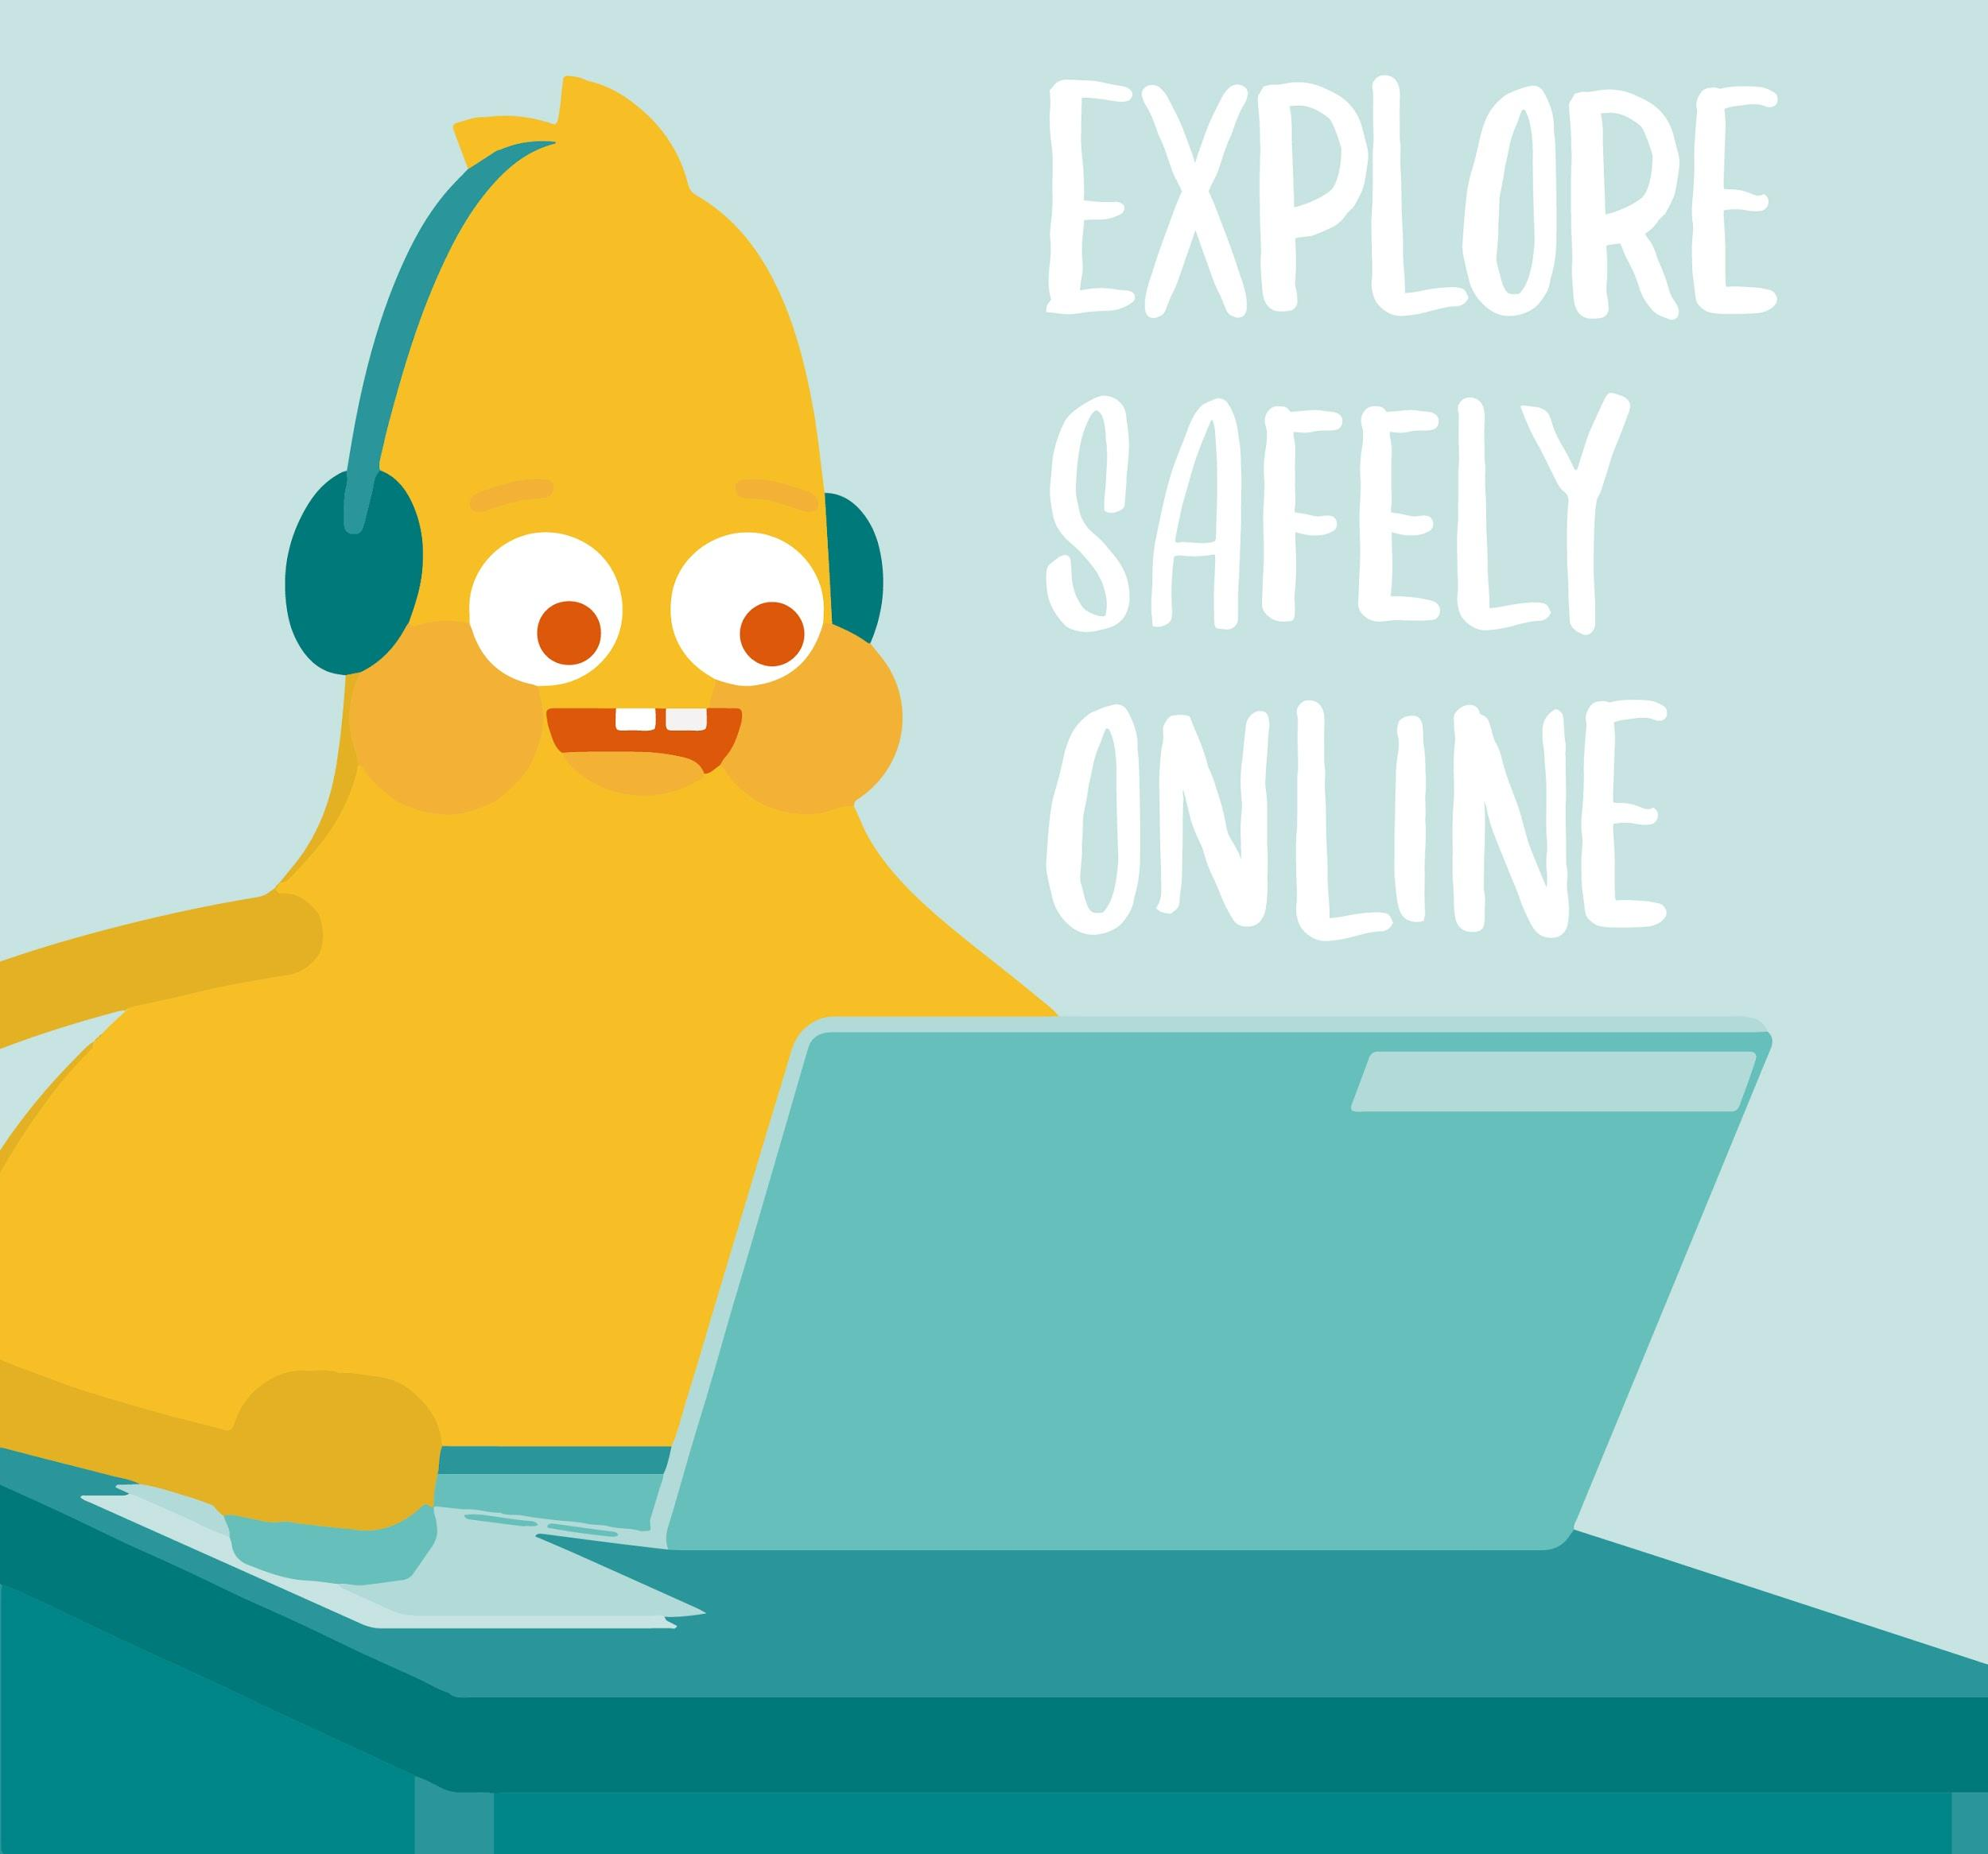
DIGITAL CITIZENSHIP | GRADE K
Safety in
My Online Neighborhood

Slide 2
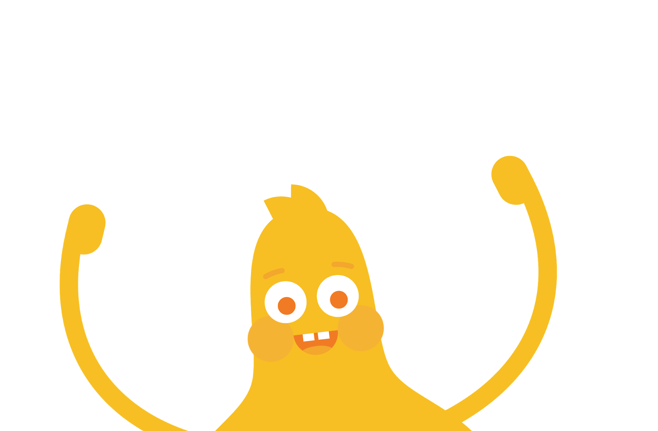

How do you go
places safely online?

Slide 3


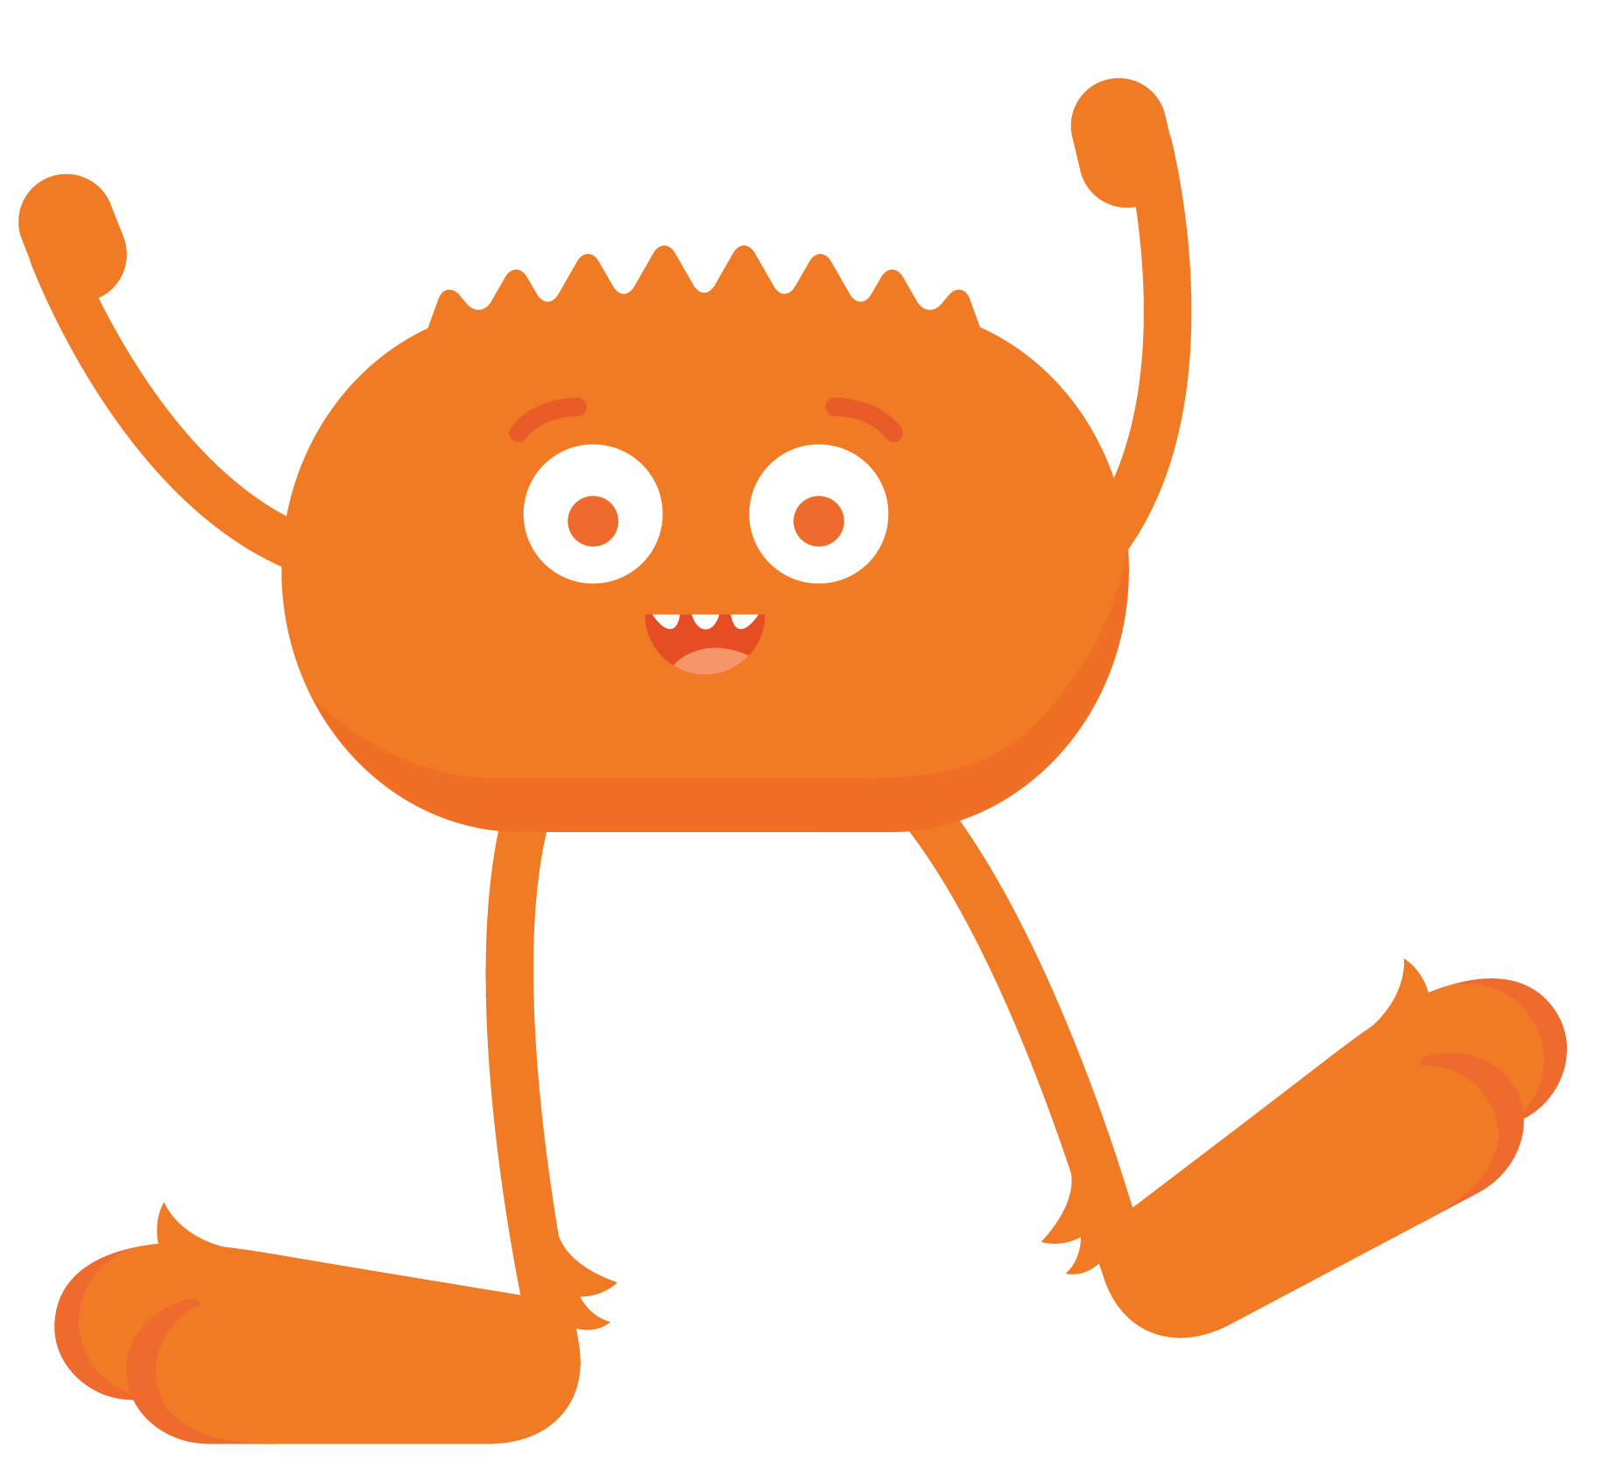
WARM UP
What do you need to do to stay safe when you visit new places?

Slide 4

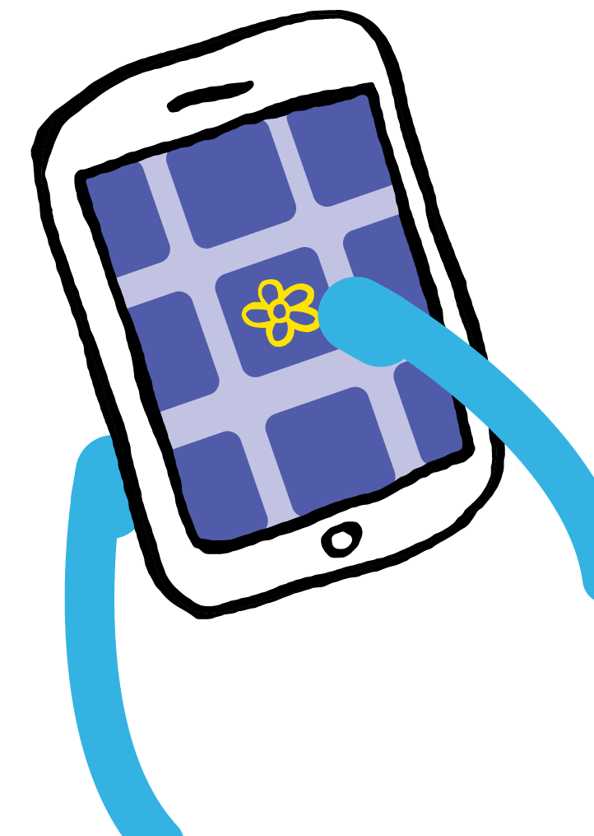

KEY VOCABULARY
Online
Using a computer, phone, or tablet to visit a website or app

Slide 5

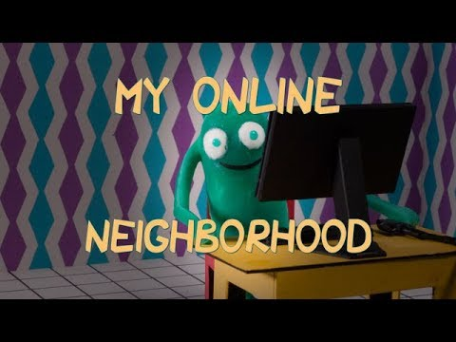
WATCH
Discuss:
What did Arms like about the internet?
What kinds of things can Arms do on the internet?
To watch this video on the Common Sense Education site, click here.

Slide 6
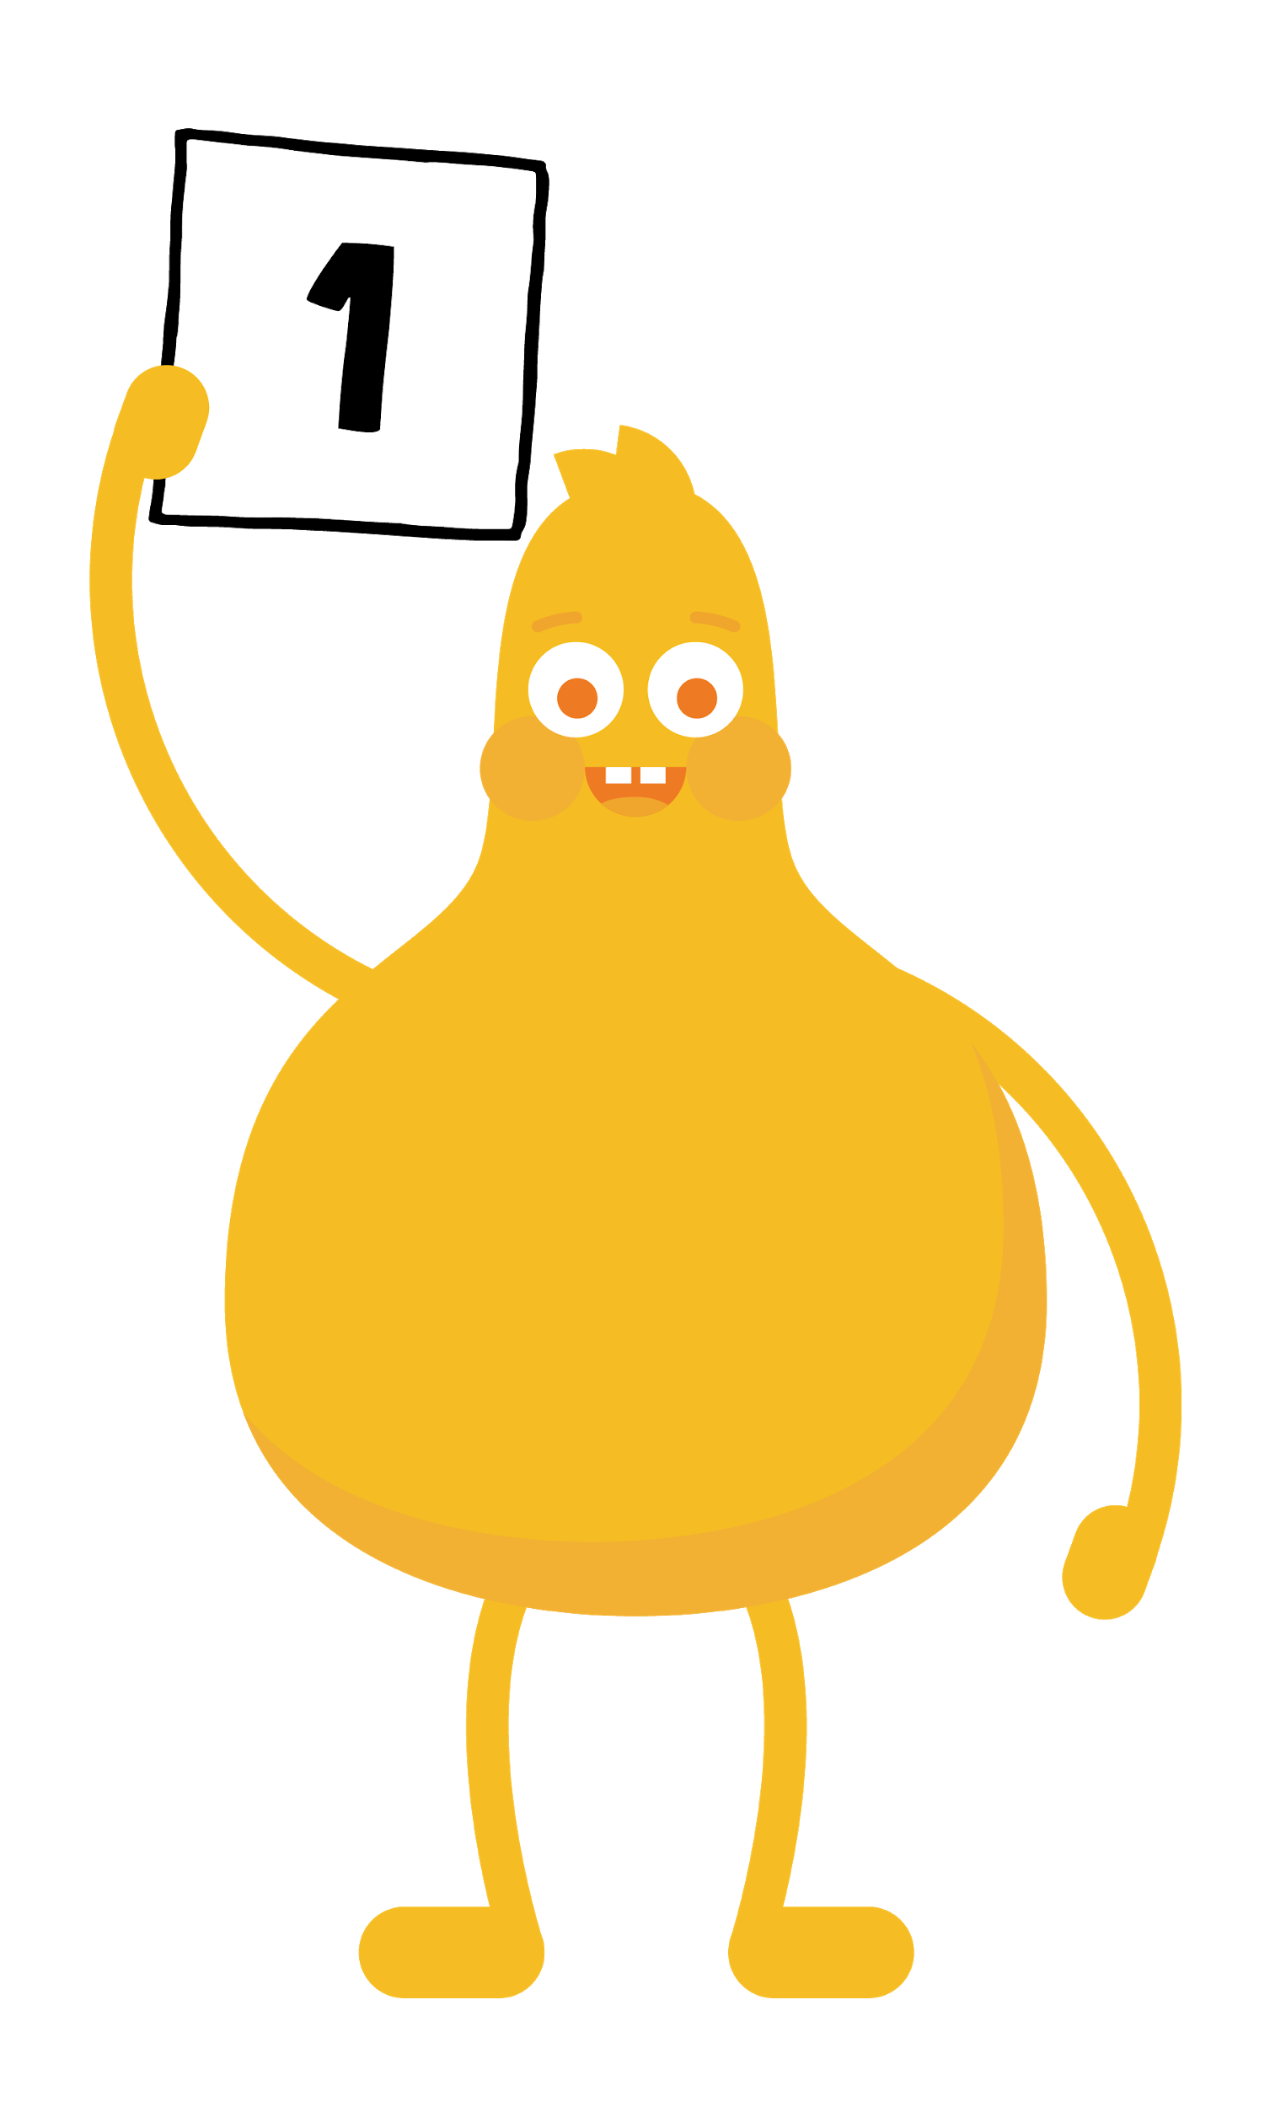
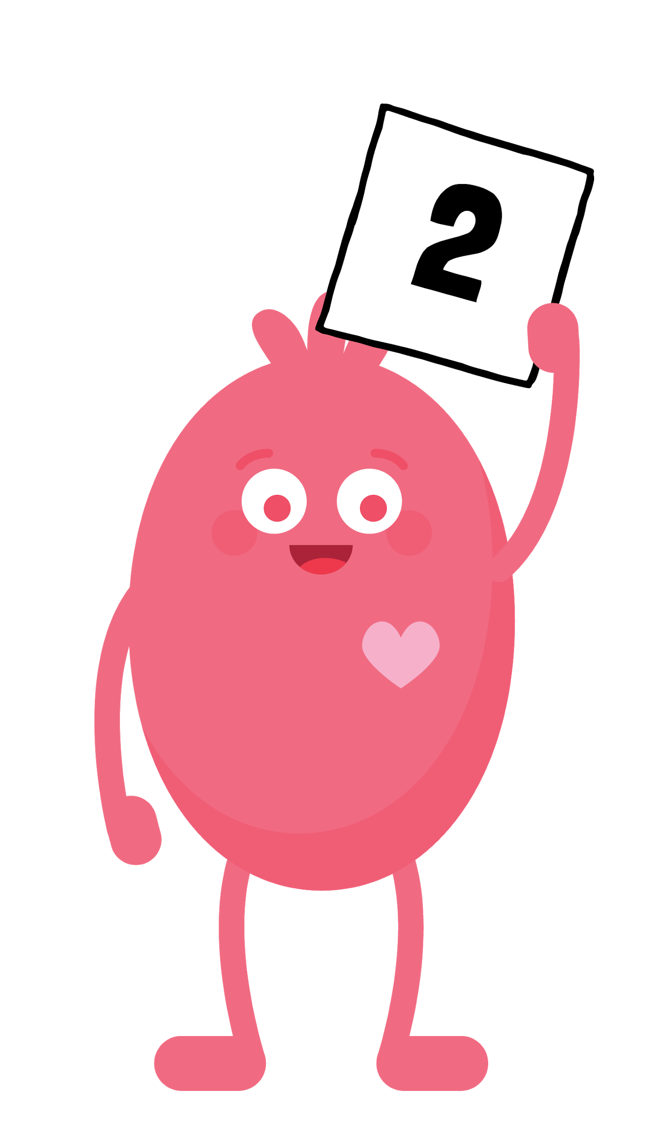
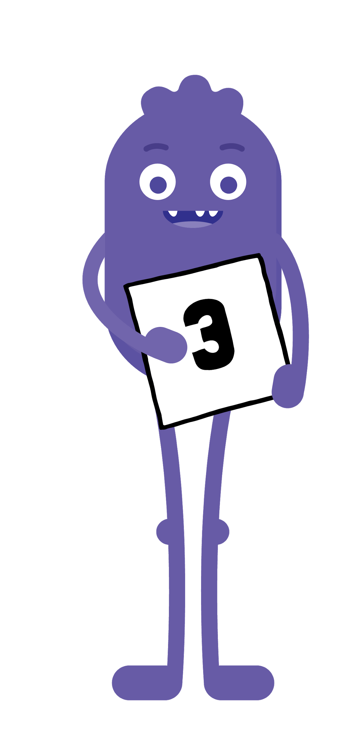
REVIEW
3 RULES
Always ask your
parent (or teacher) first
Only talk to
people you know
Stick to places that
are just right for you

Slide 7


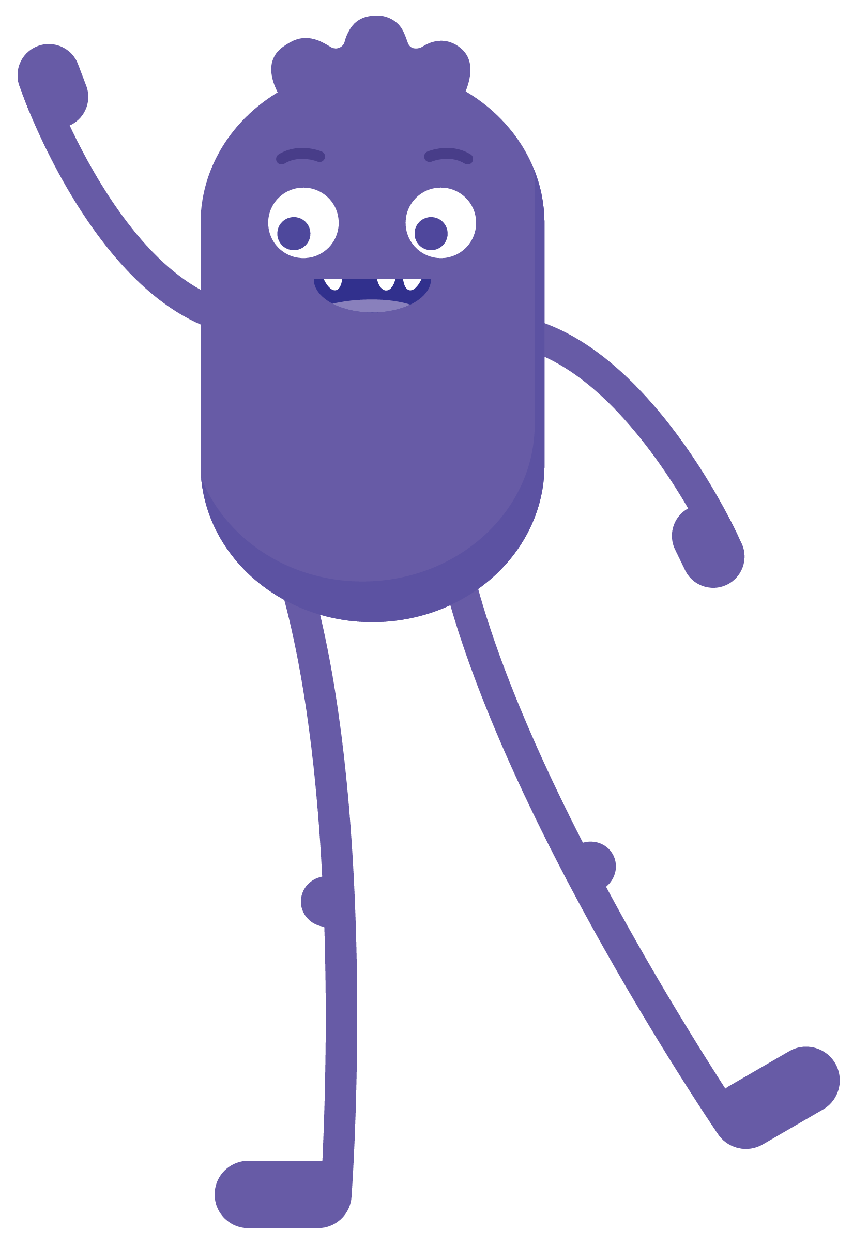

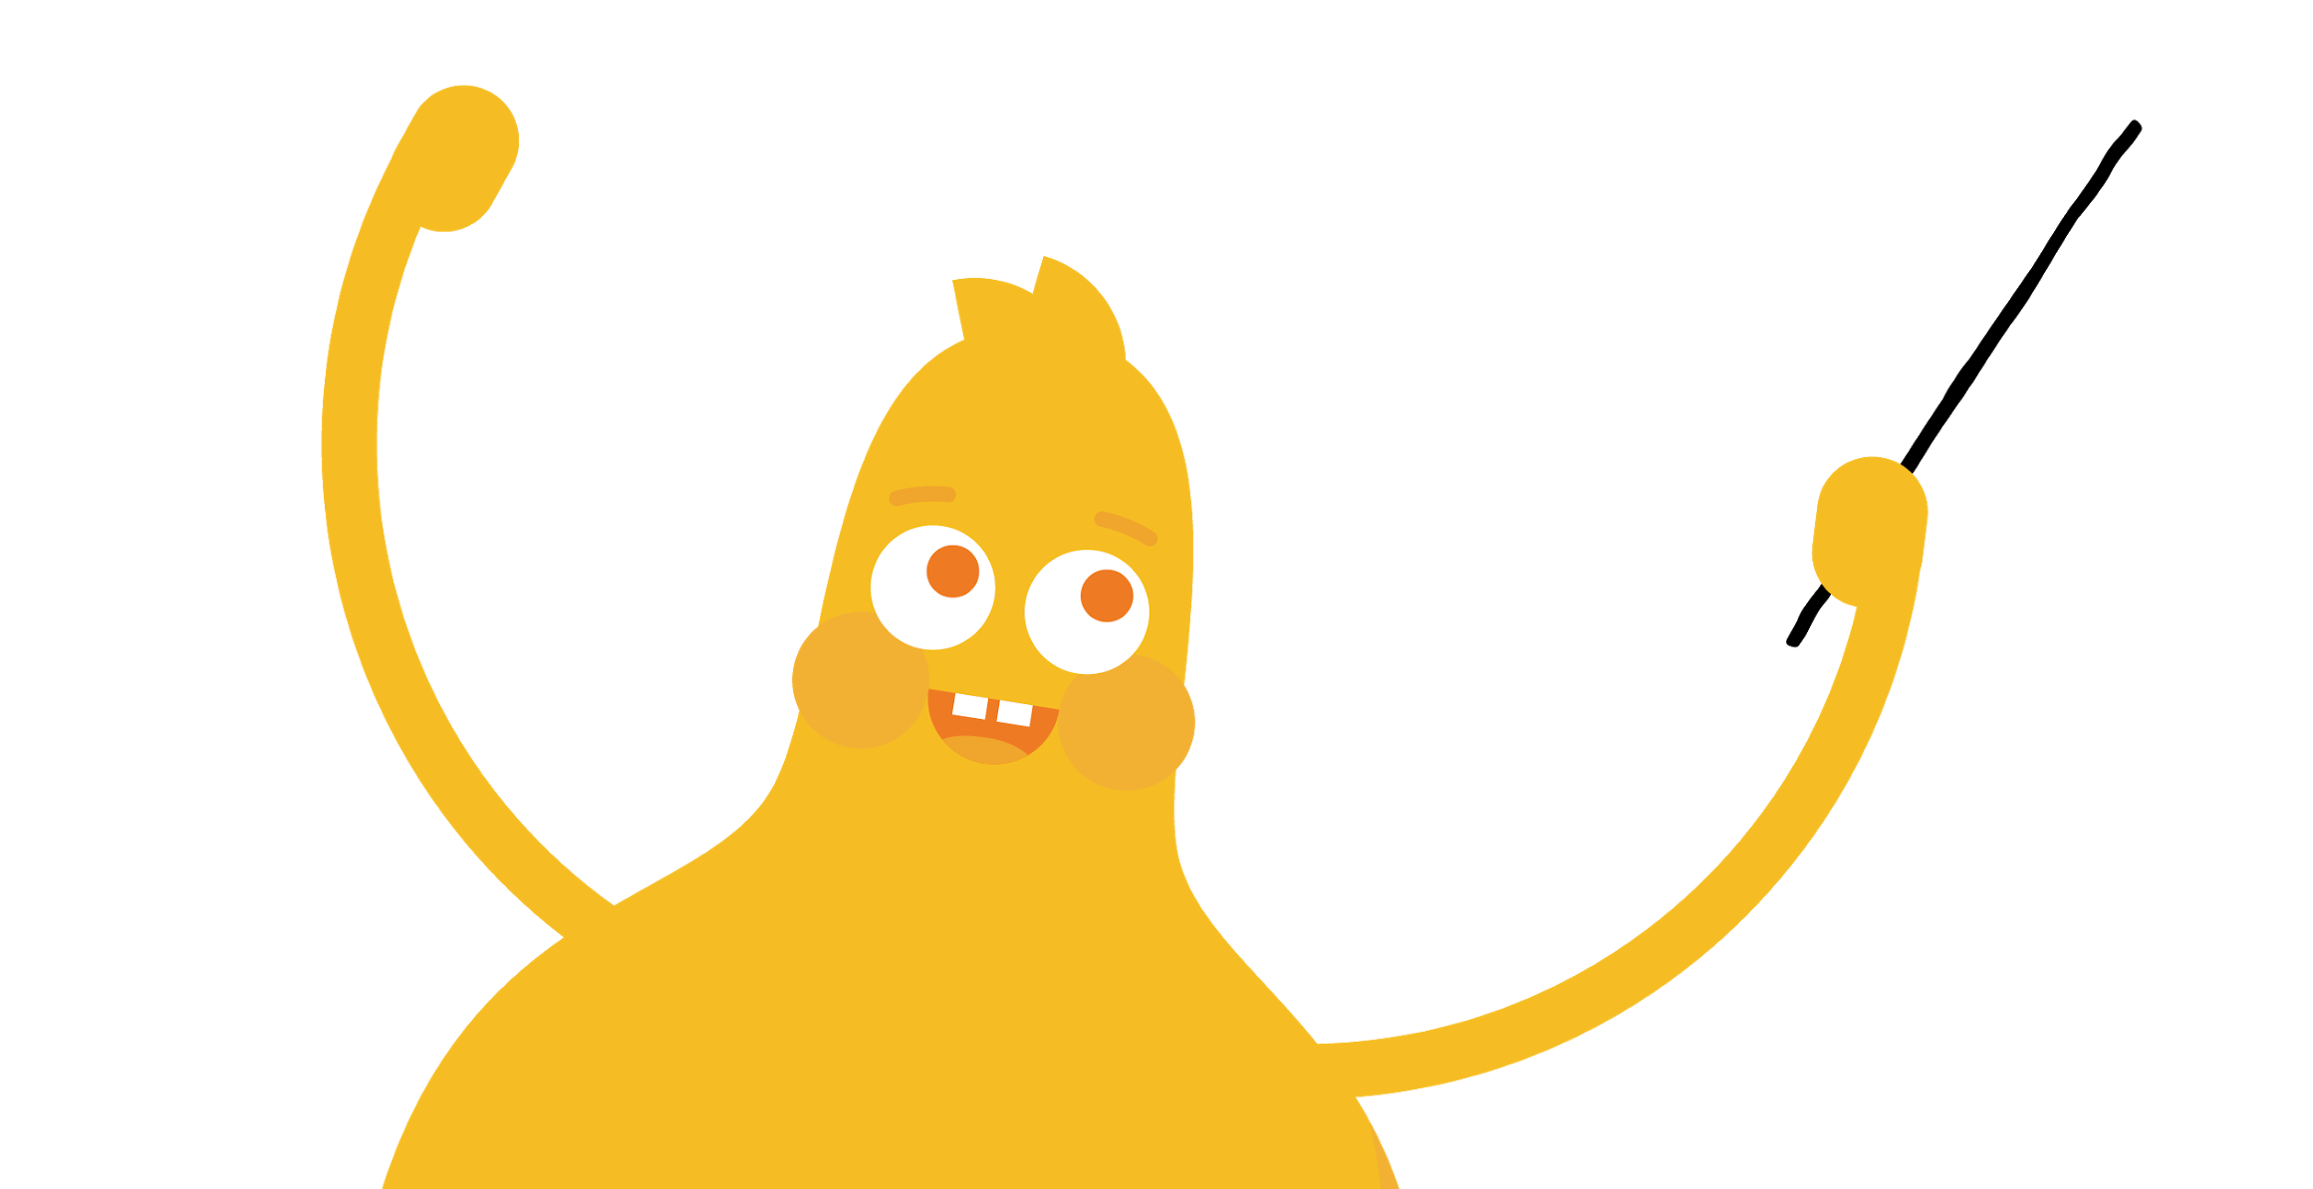

READ
Safety, It Rules!
by Jenny Pritchett
We need to be safe
Whenever we're online
So we follow these rules
To have a good time!
Always ask
your parents first!
Only talk to
people you know!
Stick to sites
just right for you!
And we'll be safe
Wherever we go!

Slide 8

KEY VOCABULARY
Website
A place you can visit on the internet

Slide 9




REFLECT HANDOUT
Pause & Think Moment
Draw a picture of yourself following one of the three rules we learned today.
and
Write a word or sentence to explain your picture.

