Slide 1

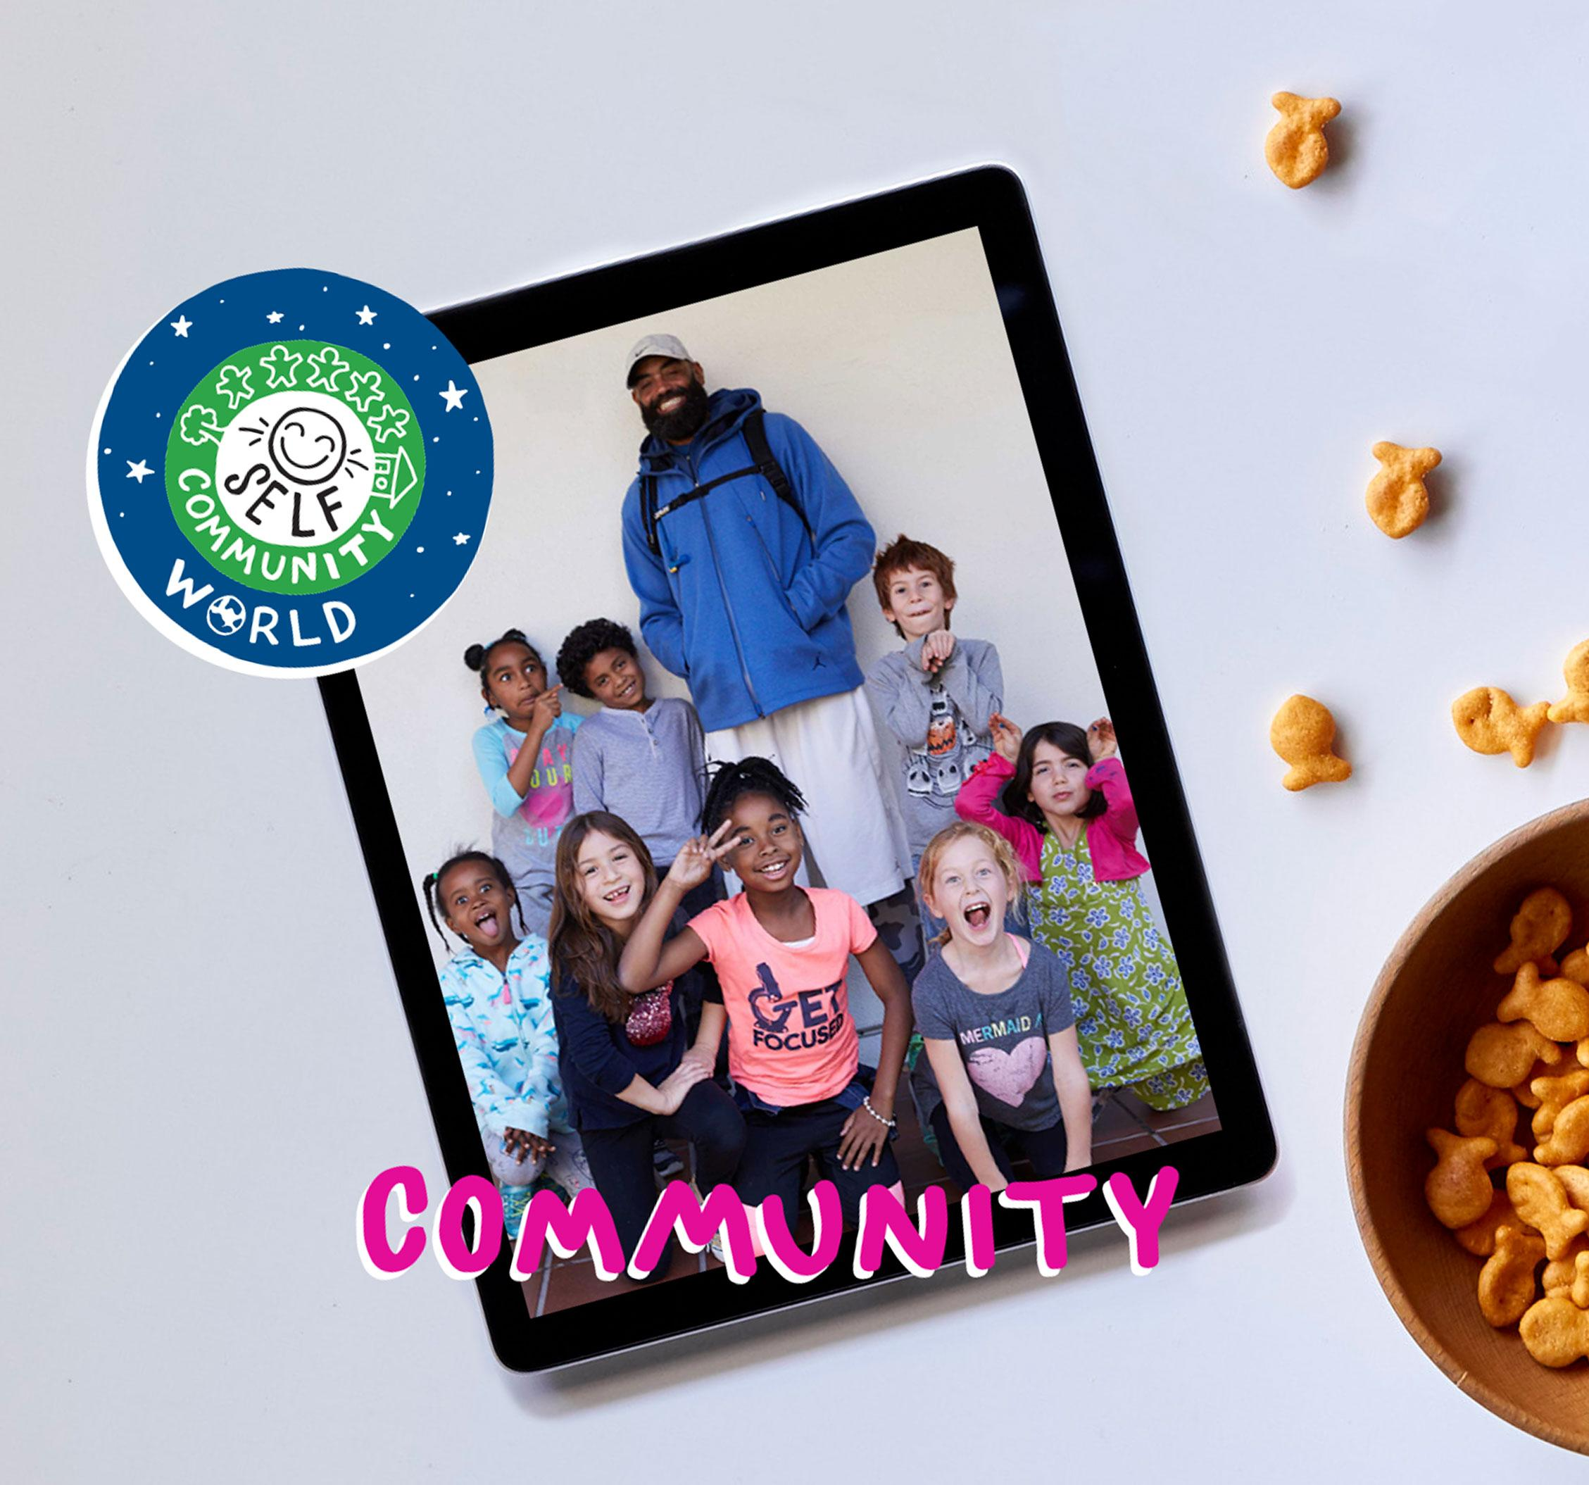

DIGITAL CITIZENSHIP
UK YEAR 4 (AGE 8-9)
Your Rings of Responsibility

Slide 2

Essential Question
How do good digital citizens take responsibility
for themselves, their communities and their world?

Slide 3

Learning Objectives
l
Examine both online and in-person responsibilities.
Describe the "Rings of Responsibility" as a way
to think about how our behavior affects ourselves
and others.
Identify examples of online responsibilities to others.
2
3

Slide 4


KEY VOCABULARY
Responsibility
A duty you have to yourself or others

Slide 5

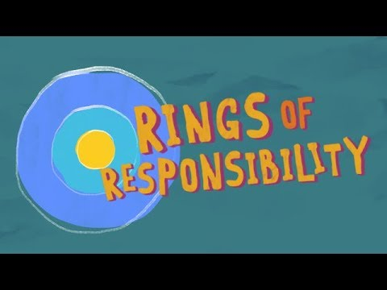
WATCH + DISCUSS
Discuss:
How could throwing a bottle out of your window be similar to something you do online?
To watch this video on the Common Sense Education site, click here.

Slide 6


OBSERVE + ANALYSE IMAGE
The Rings of Responsibility
What responsibilities do you have to yourself?
What responsibilities do you have to your community?
What responsibilities do you have to your world?

Slide 7
KEY VOCABULARY
Digital Citizen
Someone who uses technology responsibly to learn, create and participate

Slide 8

ACTIVITY: MY RINGS OF RESPONSIBILITY
My Rings of Responsibility: Directions
First, choose three colours and use them to colour in the key, then use the key colours to colour in the correct ring or rings for each statement.

Slide 9

WRAP-UP: EXIT TICKET
Directions
Pick one example from your My Rings of Responsibility handout.
Write an explanation of why it belongs in the ring(s)
that you chose.

Slide 10


