Slide 1

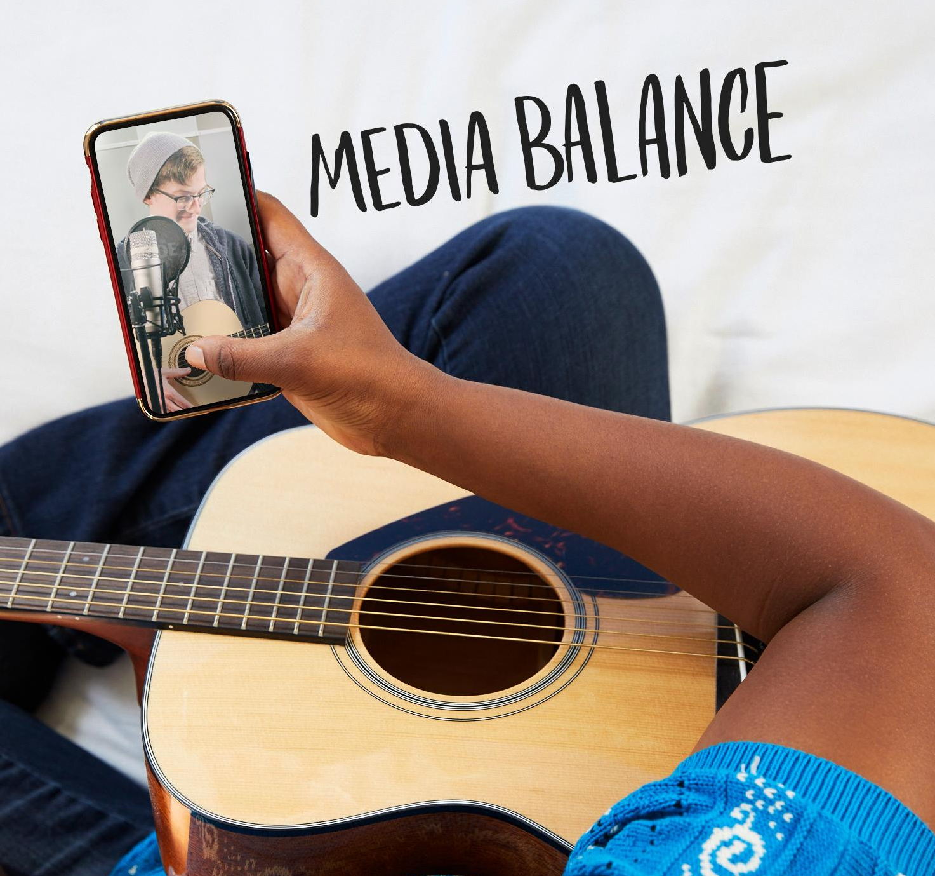
DIGITAL CITIZENSHIP | GRADE 6
Finding Balance in a Digital World

Slide 2

Essential Question
How do we balance digital media use in our lives?

Slide 3

Learning Objectives
l
Reflect on common online and offline activities.
Identify ways to "unplug" to maintain balance between online and offline activities.
Use the Digital Habits Checkup routine to create a personal challenge to achieve more media balance.
2
3

Slide 4

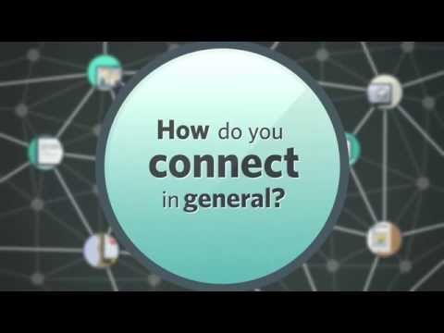
WATCH + DISCUSS
Discuss:
According to the video, what are some benefits of being connected 24/7?
To watch this video on the Common Sense Education site, click here.

Slide 5


Digital media
KEY VOCABULARY
Content (text, audio, images, video) or devices that allow people to share information, communicate, and collaborate over internet or computer networks.

Slide 6
Media balance
KEY VOCABULARY
Using media in a way that feels healthy and in balance with other life activities (family, friends, school, hobbies, etc.)

Slide 7

ACTIVITY: ONLINE, OFFLINE
Directions: Part 1
Think about the different activities you do online and offline. Write down as many as you can think of.

Slide 8
ACTIVITY: ONLINE, OFFLINE
Directions: Part 1 (continued)
Review the online and offline activities you wrote down. Circle the two or three activities in each that you do most.

Slide 9
Digital habits
KEY VOCABULARY
Behaviors we do often or regularly with digital media and devices

Slide 10
Red flag feeling
KEY VOCABULARY
When something happens on digital media that makes you feel uncomfortable, worried, sad, or anxious

Slide 11
Unplug
KEY VOCABULARY
To engage in activities that don't involve devices, apps, or the internet

Slide 12
Ways to "Unplug"
[Capture student responses here.]

Slide 13


