Slide 1


RHE Consultation 2023
Relationship and Health Education at ACE
17th May 2023
Altrincham Church of England Primary School

Slide 2
Objectives of consultation
Explain the statutory changes to requirements for RSE which were implemented in September 2020
Set out our vision for SRE with reference to our mission statement and values, and to previous consultation
Gather views from current stakeholders on what our RSE curriculum should cover
Explain how we have been delivering a bespoke curriculum to response to statutory changes, stakeholder views and, most importantly, the needs of our children
Altrincham Church of England Primary School

Slide 3
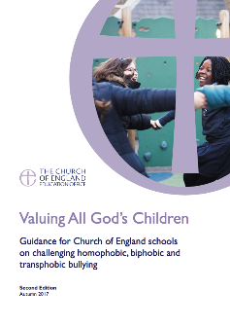


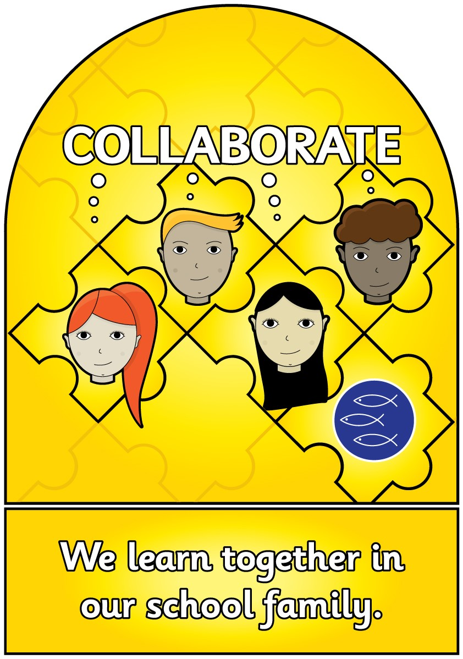
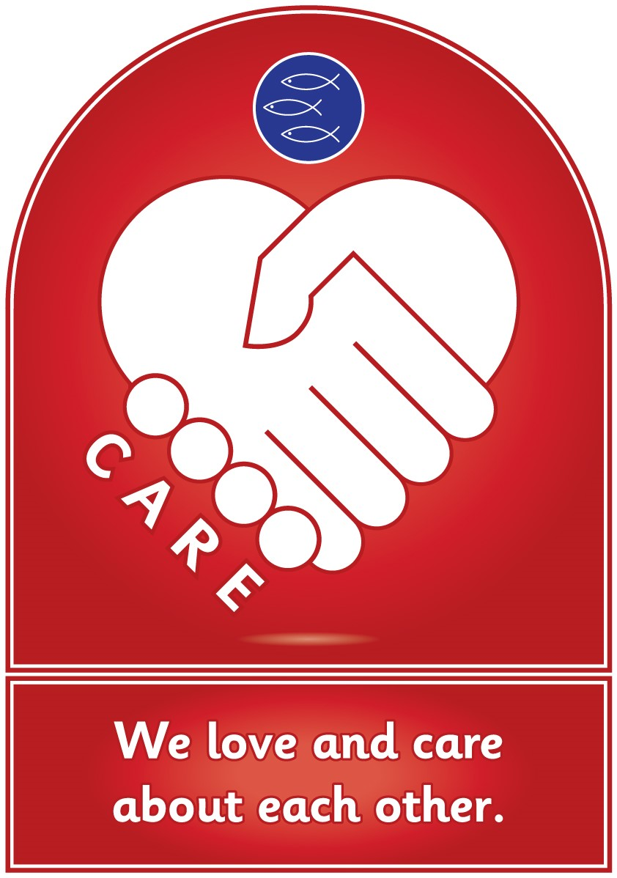
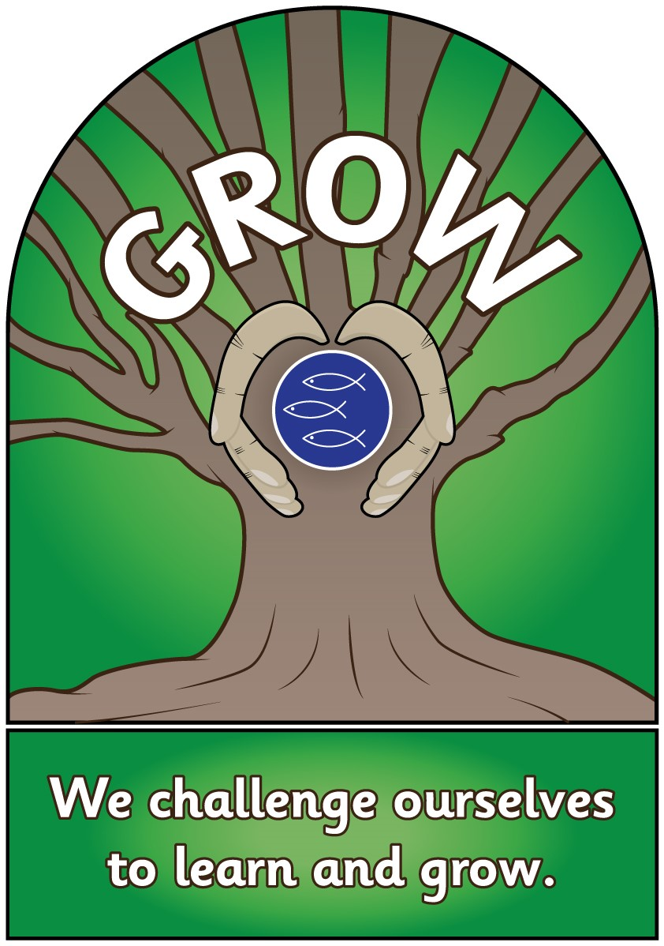
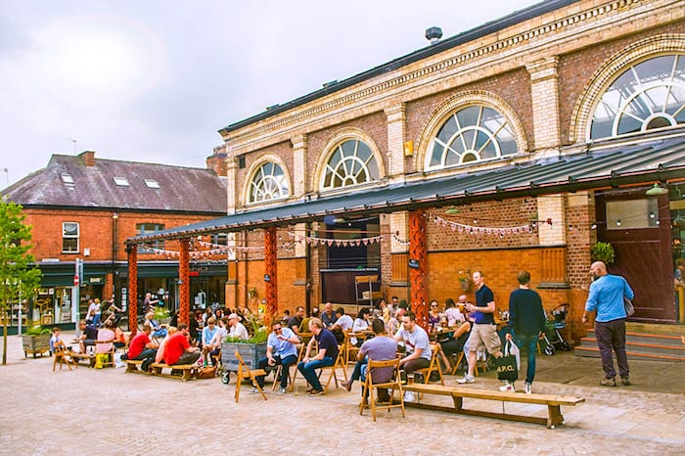
Important considerations:
Altrincham Church of England Primary School
Notes:
Q: Does the new Relationships Education and RSE curriculum take account of my faith?
A: The subjects are designed to help children from all backgrounds build positive and safe relationships, and to thrive in modern Britain.
In all schools, when teaching these subjects, the religious background of pupils must be taken into account when planning teaching, so that topics are appropriately handled. Schools with a religious character can build on the core content by reflecting their beliefs in their teaching.
In developing these subjects, we have worked with a number of representative bodies and faith organisations, representing all the major faith groups in England. Several faith organisations produce teaching materials that schools can choose to use.

Slide 4
Mission Statement and Values
Our mission statement reminds and requires us to root all that we do in Jesus’ message and example; this is particularly relevant when we are learning about relationships
Our school values of care, collaborate and grow are directly relevant to all of our Jigsaw lessons, including those related to SRE
When we talk to the children about our core school value, achieve, we emphasise that this is about personal achievement in being the best people that we can – not simply academic attainment – so this also comes into our work on SRE
Altrincham Church of England Primary School
Notes:
Q: Does the new Relationships Education and RSE curriculum take account of my faith?
A: The subjects are designed to help children from all backgrounds build positive and safe relationships, and to thrive in modern Britain.
In all schools, when teaching these subjects, the religious background of pupils must be taken into account when planning teaching, so that topics are appropriately handled. Schools with a religious character can build on the core content by reflecting their beliefs in their teaching.
In developing these subjects, we have worked with a number of representative bodies and faith organisations, representing all the major faith groups in England. Several faith organisations produce teaching materials that schools can choose to use.

Slide 5

Why teach RSE?
The Department for Education has made changes to relationships and sex education following nationwide consultation which came into effect from September 2020 and all schools are required to comply with the updated requirements. The statutory guidance can be found at:
https://www.gov.uk/government/publications/relationships-education-relationships-and-sex-education-rse-and-health-education
Altrincham Church of England Primary School
Notes:
Q: Does the new Relationships Education and RSE curriculum take account of my faith?
A: The subjects are designed to help children from all backgrounds build positive and safe relationships, and to thrive in modern Britain.
In all schools, when teaching these subjects, the religious background of pupils must be taken into account when planning teaching, so that topics are appropriately handled. Schools with a religious character can build on the core content by reflecting their beliefs in their teaching.
In developing these subjects, we have worked with a number of representative bodies and faith organisations, representing all the major faith groups in England. Several faith organisations produce teaching materials that schools can choose to use.

Slide 6
Why teach RSE?
The guidance focuses on healthy relationships and keeping children safe in the modern world. It also covers a wide range of topics relating to physical and mental health, wellbeing, safeguarding and healthy relationships.
Learning about the emotional, social and physical aspects of growing up will give children and young people the information, skills and positive values to have safe, fulfilling relationships and help them take responsibility for their own well-being.
Consequently, from September 2020, Relationships and Sex Education (RSE), along with Health Education, has been statutory, and forms part of the National Curriculum.
Altrincham Church of England Primary School

Slide 7

What do schools need to teach?
Relationship Education
Families and people who care for me
Caring Friendships
Respectful Relationships
Online Relationships
Being Safe
Health Education
Mental Wellbeing
Internet Safety and Harms
Physical Health and fitness
Healthy Eating
Drugs, alcohol and tobacco
Health prevention
Basic First aid
Changing adolescent bodies
Sex Education
Not compulsory
More information in handouts
Altrincham Church of England Primary School
Notes:
Q: Will my child be taught sex education at primary? This is too young.
A: We are not introducing compulsory sex education at primary school.
We are introducing Relationships Education at primary, to put in place the building blocks needed for positive and safe relationships of all kinds. This will start with family and friends, how to treat each other with kindness, and recognising the difference between online and offline friendships.
Some primary schools choose to teach sex education (which goes beyond the existing national curriculum for science), and in those instances we recommend you discuss this with the school to understand what they propose to teach and how. If you continue to have concerns, you have an automatic right to withdraw your child from these lessons.

Slide 8

Families and people who care for me
That families are important for children growing up because they can give love, security and stability
The characteristics of healthy family life, commitment to each other, including in times of difficulty, protection and care for children and other family members, the importance of spending time together and sharing each other’s lives
That others’ families, either in school or in the wider world, sometimes look different to their family, but that they should respect those differences and know that other children’s families are also characterized by love and care
That stable, caring relationships, which may be of different types, are at the heart of happy families, and are important for children’s security as they grow up
That marriage represents a formal and legally recognized commitment of two people to each other which is intended to be lifelong
How to recognise if family relationships are making them feel unhappy or unsafe, and how to seek help or advice from others if needed
Notes:
Q: Will these subjects promote LGBT relationships?
A: No, these subjects don’t ‘promote’ anything, they educate.
Pupils should be taught about the society in which they are growing up. These subjects are designed to foster respect for others and for difference, and educate pupils about healthy relationships. RSE should meet the needs of all pupils, whatever their developing sexuality or identity – this should include age-appropriate teaching about different types of relationships in the context of the law.
Pupils should receive teaching on LGBT relationships during their school years - we expect secondary schools to include LGBT content. Primary schools are enabled and encouraged to cover LGBT content if they consider it age appropriate to do so, but there is no specific requirement for this. This would be delivered, for example, through teaching about different types of family, including those with same sex parents.

Slide 9
Caring Friendships
How important friendships are in making us feel happy and secure, and how people choose and make friends
The characteristics of friendships, including mutual respect, honesty, trustworthiness, loyalty, kindness, generosity, sharing interests and experiences and support with problems and difficulties
That healthy friendships are positive and welcoming towards others, and do not make others feel lonely or excluded
That most friendships have ups and downs, and that these can often be worked through so that the friendship is repaired or even strengthened, and that resorting to violence is never right
How to recognise who to trust and who not to trust, how to judge when a friendship is making them feel unhappy or uncomfortable, managing conflict, how to managing these situations and how to seek help or advice from others if needed

Slide 10
Respectful Relationships
The importance of respecting others, even when they’re very different from them (for example, physically, in character, personality or backgrounds), or make different choices or have different preferences or beliefs
Practical steps they can take in a range of different contexts to improve or support respectful relationships
The conventions of courtesy and manners
The importance of self-respect and how this links to their own happiness
That in school and in the wider world they can expect to be treated with respect by others, and that in turn they should show respect to others, including those in positions of authority
About different types of bullying (including cyberbullying), the impact of bullying, responsibilities of bystanders (primarily reporting bullying to an adult) and how to get help
What a stereotype is, and how stereotypes can be unfair, negative or destructive
The importance of permission-seeking and giving in relationships with friends, peers and adults
Handout

Slide 11
Online Relationships
That people sometimes behave differently online, including by pretending to be someone they’re not
That the same principles apply to online relationships as face-to-face relationships, including the importance of respect for other online (even when we’re anonymous)
The rules and principles for keeping safe online, how to recognise risks, harmful content and contact, and how to report them
How to critically consider their online friendships and sources of information, including awareness of the risks associated with people they’ve never met
How information and data is shared and used online

Slide 12
Being Safe
What sorts of boundaries are appropriate in friendships with peers and others (including in a digital context)
About the concept of privacy and the implications of it for both children and adults (including that its not always right to keep secrets if they relate to being safe)
That each person’s body belongs to them, and the differences between appropriate and inappropriate/unsafe physical and other contact
How to respond safely and appropriately to adults they may encounter (in all contexts, including online) who they don’t know
How to recognise and report feelings of being unsafe or feeling bad about any adult
How to ask for advice or help for themselves or others, and to keep trying until they’re heard
How to report concerns or abuse, and the vocabulary and confidence needed to do so
Where to get advice (e.g. family, school, other sources)

Slide 13
Mental Wellbeing
That mental wellbeing is a normal part of daily life, in the same way as physical health
That there is a normal range of emotions (e.g. happiness, sadness, anger, fear, surprise, nervousness) and scale of emotions that all humans experience in relation to different experiences and situations
How to recognise and talk about their emotions, including having a varied vocabulary of words to use when talking about their own and others’ feelings
How to judge whether what they're feeling and how they're behaving is appropriate and proportionate
The benefits of physical exercise, time outdoors, community participation, voluntary and service-based activity on mental wellbeing and happiness
Simple self-care techniques, including the importance of rest, time spent with friends and family, and the benefits of hobbies and interests
Isolation and loneliness can affect children and that it's very important for children to discuss their feelings with an adult and seek support
That bullying (including cyberbullying) has a negative and often lasting impact on mental wellbeing
Where and how to seek support (including recognising the triggers for seeking support), including whom in school they should speak to if they're worried about their own or someone else’s mental wellbeing or ability to control their emotions (including issues arising online)
It's common for people to experience mental ill health. For many people who do, the problems can be resolved if the right support is made available, especially if accessed early enough

Slide 14
Internet Safety and Harms
That for most people the internet is an integral part of life and has many benefits
About the benefits of rationing time spent online, the risks of excessive time spent on electronic devices and the impact of positive and negative content online on their own and others’ mental and physical wellbeing
How to consider the effect of their online actions on others and know how to recognise and display respectful behaviour online and the importance of keeping personal information private
Why social media, some computer games and online gaming, for example, are age restricted
That the internet can also be a negative place where online abuse, trolling, bullying and harassment can take place, which can have a negative impact on mental health
How to be a discerning consumer of information online including understanding that information, including that from search engines, is ranked, selected and targeted
Where and how to report concerns and get support with issues online

Slide 15
Physical health and fitness
The characteristics and mental and physical benefits of an active lifestyle
The importance of building regular exercise into daily and weekly routines and how to achieve this; for example walking or cycling to school, a daily active mile or other forms of regular, vigorous exercise
The risks associated with an inactive lifestyle (including obesity)
How and when to seek support including which adults to speak to in school if they're worried about their health
Healthy eating
What constitutes a healthy diet (including understanding calories and other nutritional content)
The principles of planning and preparing a range of healthy meals
The characteristics of a poor diet and risks associated with unhealthy eating (including, for example, obesity and tooth decay) and other behaviours (e.g. the impact of alcohol on diet or health)

Slide 16
Health and Prevention
How to recognise early signs of physical illness, such as weight loss or unexplained changes to the body
About safe and unsafe exposure to the sun, and how to reduce the risk of sun damage, including skin cancer
The importance of sufficient good quality sleep for good health and that a lack of sleep can affect weight, mood and ability to learn
About dental health and the benefits of good oral hygiene and dental flossing, including regular check-ups at the dentist
About personal hygiene and germs including bacteria, viruses, how they're spread and treated, and the importance of handwashing
The facts and science relating to immunisation and vaccination

Slide 17
Basic first aid
How to make a clear and efficient call to emergency services if necessary
Concepts of basic first aid, for example dealing with common injuries, including head injuries
Changing adolescent bodies
Key facts about puberty and the changing adolescent body, particularly from age 9 through to age 11, including physical and emotional changes
About menstrual wellbeing including the key facts about the menstrual cycle

Slide 18
Sex Education Expectations
There's no list of expectations for sex education at the primary level, as it isn't compulsory, but if you choose to teach it then the DfE recommends that it should:
Make sure boys and girls are prepared for the changes that adolescence brings
Draw on knowledge of the human life cycle set out in science lessons to explain how a baby is conceived and born

Slide 19
What do you think/notice about these expectations?

Slide 20
Flexibility in delivery
The guidance allows us to differentiate and personalise for pupils based on factors like:
Age
Physical and emotional maturity
Religious backgrounds
Special educational needs and disabilities (SEND)
However, in any case, our teaching will need to reflect current law as it applies to relationships, so that our pupils understand what the law does and doesn't allow.

Slide 21
RSE
‘Today’s children and young people are growing up in an increasingly complex world and living their lives seamlessly on and offline….children and young people need to know how to be safe and healthy, and how to manage their academic, personal and social lives in a positive way’
Secretary of State for Education

Slide 22
What are the expectations for Science related to Sex Education?
Statutory Science programmes of study:
key stages 1 and 2 National curriculum in England September 2013
Year 1
identify, name, draw and label the basic parts of the human body and say which part of the body is associated with each sense.
Year 2
notice that animals, including humans, have offspring which grow into adults
  (Non-statutory note: Pupils should be introduced to …the processes of reproduction and growth in animals. The focus at this stage should be on questions that help pupils to recognise growth; they should not be expected to understand how reproduction occurs)
Years 3 and 4
Nothing in Science curriculum related to puberty or reproduction!
Notes:
In the statutory guidance there is no statutory sex education in primary schools but the guidance says, ‘the Department recommends that all primary schools should have a sex education programme tailored to the age and the physical and emotional maturity of the pupils. It should ensure that both boys and girls are prepared for the changes that adolescence brings and-drawing on knowledge of the human life cycle set out in national curriculum Science, how a baby is conceived and born.
Make the point that we know some girls start their periods as young as Year 3… so we can’t rely on Science curriculum to equip them for this

Slide 23
What are the expectations for Science related to Sex Education?
Year 5
describe the differences in the life cycles of a mammal, an amphibian, an insect and a bird
describe the life process of reproduction in some plants and animals
  (Non-statutory note: Pupils should find out about different types of reproduction, including sexual and asexual reproduction in plants, and sexual reproduction in animals)
describe the changes as humans develop to old age.
  (Non-statutory note: Pupils should draw a timeline to indicate stages in the growth and development of humans. They should learn about the changes experienced in puberty.
  Pupils could work scientifically by researching the gestation periods of other animals and comparing them with humans; by finding out and recording the length and mass of a baby as it grows)
Notes:
In the statutory guidance there is no statutory sex education in primary schools but the guidance says, ‘the Department recommends that all primary schools should have a sex education programme tailored to the age and the physical and emotional maturity of the pupils. It should ensure that both boys and girls are prepared for the changes that adolescence brings and-drawing on knowledge of the human life cycle set out in national curriculum Science, how a baby is conceived and born.

Slide 24
What are the expectations for Science related to Sex Education?
Year 6
recognise that living things produce offspring of the same kind, but normally offspring vary and are not identical to their parents
QUESTIONS:
Is this enough to ensure children know about puberty and how babies are born?
Is this enough information to help children keep themselves SAFE in today’s world?
Notes:
In the statutory guidance there is no statutory sex education in primary schools but the guidance says, ‘the Department recommends that all primary schools should have a sex education programme tailored to the age and the physical and emotional maturity of the pupils. It should ensure that both boys and girls are prepared for the changes that adolescence brings and-drawing on knowledge of the human life cycle set out in national curriculum Science, how a baby is conceived and born.

Slide 25
RSE
When and where did you learn about relationship and sex?
Was this the best way?
Was there anything that you didn’t understand?
Was there anything you were frightened about?
Has the world changed since then?

Slide 26
RSE
Would accurate information at the right age and stage of development, coming from school AND home, be a better way?
What do you think children should know about relationships and why?

Slide 27
RSE
As we introduce the new statutory RSE and health education curriculum, supporting parents in their role as their children’s primary educators will help schools because it:
Reinforces positive outcomes for RSE and health education at school.
Furthers the school-home partnership.
Fulfils the requirements for parental consultation in the Department for Education RSE and health education statutory guidance (DfE, 2019a).
Meets criteria for Ofsted inspection on parental engagement.
Complements other areas of the curriculum such as PSHE, SMSC, citizenship and media and digital literacy.
Shores up children’s confidence and resilience and emphasises parents’ role as their children’s primary educators.
Parents and school are children’s top two preferred sources of information about sex and relationships, according to the Sex Education Forum’s Briefing for Parliamentarians (SEF, 2019a). The 2019 SEF Young People’s RSE Poll found that 48 per cent of respondents rated the quality of RSE they received from their parents as “good/very good”. However, 19 per cent – one in five – rated it as “bad/very bad” (SEF, 2019b).

Slide 28

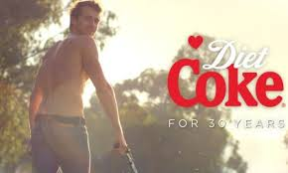
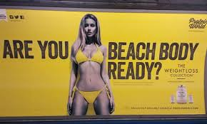

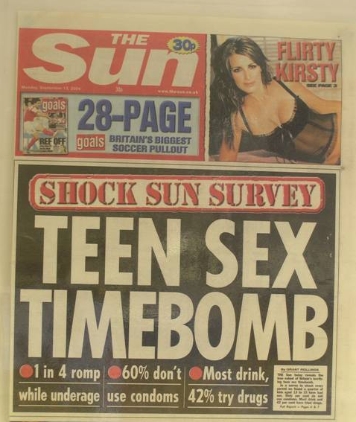


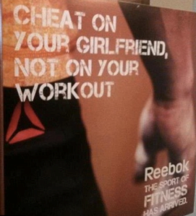

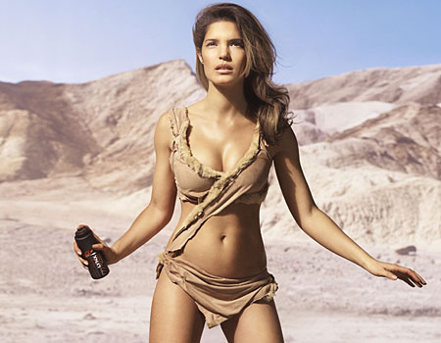

Today’s considerations
The internet
Television
Social media
Other media
Friends
Family
School
Notes:
If we are trying to keep children safe…what do we need to consider?
IS THIS SEX ED OR RELATIONSHIPS ED OR HEALTH ED?
DOES IT MATTER AS LONG AS CHILDREN ARE EQUIPPED TO STAY SAFE, HEALTHY, HAPPY ETC?
What do we have to consider when it comes to the needs and experiences of today’s children and young people?
Are there any others not on this list?
NB: the logos are for Facebook, Twitter, Snapchat, Instagram and Tinder.

Slide 29
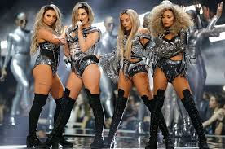
Music and lyrics
Heard he in love with some other chick
Yeah yeah, that hurt me, I'll admit
Forget that boy, I'm over it
I hope she gettin’ better sex
Hope she ain't fakin’ it like I did, babe
Took four long years to call it quits
Forget that boy, I'm over it
‘Shout out to my ex’ by Little Mix
Notes:
Can we protect our children from all the things we don’t want them to see/hear?

Slide 30

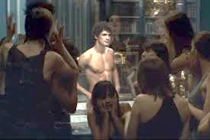
What are the ‘messages’ in these adverts?
Notes:
We are not suggesting parents let their children see this type of adverts but we are suggesting that the world surrounds children with sexually-oriented influences/media, so we need to equip children to understand what healthy and positive relationships are, and how to keep themselves safe.

Slide 31
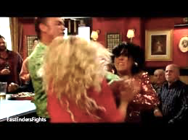
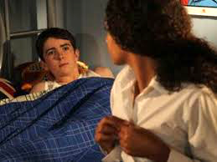
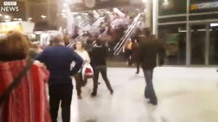
What ‘messages’ are in these TV scenes?
Eastenders ‘Kat vs Roxy’
Hollyoaks ‘Finn and Amber sleep together’
BBC News ‘ Manchester Arena Attack’
Notes:
How much of the media coverage about relationships is positive, showing healthy, positive, caring relationships?

Slide 32
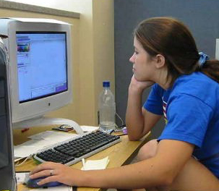
Chat Rooms/Forums
Hi. You sound real cute!!
How old are you and what do you like doing after school?
Notes:
Without trying to scare-monger, ensure everyone realises the gravity of why high-quality RSE is so vital.
NOTE: click again to reveal the picture on the other side of the slide.

Slide 33
Two 10-year old girls being groomed online: They said the men were ‘friendly’ and felt that it was perfectly acceptable to text pictures of themselves in their underwear and wearing make-up.
7-year olds accessing pornography through click-bait.
Year 6 pupil accessing ‘hard core’ porn. Sex Ed was only taught in Yr6 but his parents withdrew him so he missed the lessons.
Child abuse case: Uncle (the abuser) acquitted because in the child’s testimony she used the word ‘Frou Frou’ to describe her vulva. The lawyer said that Frou Frou was the name of a soft toy and the child was ‘prone to lying’.

Slide 34
Keeping children SAFE
Ignorance does not protect innocence…but may make children vulnerable.
PSHE (Personal, Social, Health Education) including Relationships Education, Health Education and Sex Education aims to keep children safe.
We believe we need to teach Relationships and Sex Education which
goes further than the Science curriculum.
When it comes to sex, children’s heads are probably not empty – but they may be full of myths and half-truths
We mustn’t let our adult knowledge of relationships and sex prevent us seeing things from a child’s perspective
Our focus should be on building healthy attitudes and positive relationships, not just fighting off perceived threats
Notes:
Stress that RSE is partly about safeguarding children and young people

Slide 35

What is Jigsaw?
A whole-school PSHE program comprising:
A comprehensive and completely original scheme of work for ages 3 to 16
PSHE (Personal, Social, and Health Education) Includes statutory Relationships and Health Education
A detailed weekly lesson plan for all year groups, including all teaching resources
The Jigsaw Approach, underpinned by mindfulness
Assemblies, Jigsaw Friends, Jigsaw Chimes, original music and songs
© Jan Lever
Notes:
Share the aims of the session and check that this covers everyone’s expectations.

Slide 36

Whole-school approach from 3-16
Being Me in My World
Celebrating Difference
Dreams and Goals
Healthy Me
Relationships
Changing Me
GOLDEN THREADS
Relationships
Values
Mental health
Self-esteem
Social skills
Safeguarding inc.
Internet safety
© Jan Lever
Notes:
These are the units of study in Jigsaw PSHE.
Explain that the DfE statutory requirements sit within this whole-school PSHE Programme:
Relationships…in the Relationships Puzzle but also throughout as we start with building a positive relationship with self
Health Education…in Healthy Me
Additionally Changing Me covers Puberty and human reproduction specifically in Years 5 and 6
Being Me In My World: A sense of belonging; Welcoming others; Building the positive and nurturing ethos of the class/school; Being part of a school community, a wider community, a global community; Rights (UNCRC) and responsibilities; Working and socialising with others; School Council and pupil voice; The Learning Charter: rights, responsibilities, rewards and consequences.
Celebrating Difference: Similarities and differences – diversity; Appearance, disability, racism, power, friendships, conflict; Accepting everyone’s right to ‘difference’, regardless of their circumstances or choices; What is ‘normal’?; Bullying – what it is and what it isn’t, including cyber and homophobic bullying.
Dreams and Goals: Hopes and dreams; Goals to success; Learning and personal strengths; Challenges – team work skills and tasks; Overcoming obstacles; Enterprise and fundraising; Experiencing and managing feelings of pride, ambition, disappointment, success; Aspirations – jobs and careers; Dreams and goals of others in different cultures/countries; Dreams for the world .
Healthy Me: Emotional health (Relaxation, being safe, friendships, mental health skills, body image, relationships with food, managing stress) and Physical health (Eating a balanced diet, physical activity, rest and relaxation, keeping clean, drugs and alcohol, being safe, first aid).
Relationships: Families; Friendships; Love and Loss; Memories; Grief cycle; Pets and animals; Safeguarding and keeping safe; Attraction; Assertiveness; Conflict; Own strengths and self-esteem; Cyber safety and social networking; Roles and responsibilities in families; Stereotypes; Communities; Wider communities
Changing Me: Life cycles; How babies are made; My changing body; Puberty; How babies grow; Growing from young to old; Becoming a teenager; Assertiveness; Self-respect; Safeguarding; Family stereotypes; Self and body image; Attraction; Change; Accepting change; Looking ahead; Moving/transition to secondary.

Slide 37



Relationships, Puberty and Reproduction in Jigsaw 3-11
Relationships
Changing Me
Families
Friendships
Love and Loss
Memories
Grief cycle
Safeguarding and keeping safe
Attraction
Assertiveness
Conflict
Own strengths and self-esteem
Cyber safety and social networking
Roles and responsibilities in families
Stereotypes
Communities
* Life cycles
* How babies are made
* My changing body
* Puberty
Growing from young to old / Becoming a teenager
Assertiveness
Self-respect
Safeguarding
Family stereotypes
Self and body image
Attraction
Change / Accepting change
Looking ahead / Moving/transition to secondary
© Jan Lever
Notes:
Explain where the statutory requirements for Relationships and what could be called Sex Ed are included in Jigsaw
Explain therefore that the only part parents have the right to withdraw their children from is the
‘How babies are made’ lessons in Years 5 and 6

Slide 38
Puberty and Human Reproduction in Jigsaw 3-11
FS | Growing Up | How we have changed since we were babies
Y1 | My changing body | Understanding that growing and changing is natural and happens to everybody at different rates
 | Boys’ and girls’ bodies | Appreciating the parts of the body that make us different and using the correct names for them
Y2 | The changing me | Where am I on the journey from young to old, and what changes can I be proud of?
 | Boys and girls | Differences between boys and girls – how do we feel about them? Which parts of me are private?
Y3 | Outside body changes | How our bodies need to change so they can make babies when we grow up – outside changes and how we feel about them
 | Inside body changes | How our bodies need to change so they can make babies when we grow up – inside changes and how we feel about them (animations used – shorter version Female and Male Reproductive Systems)
© Jan Lever
Notes:
ALL THIS FALLS WITHIN THE STATUTORY HEALTH EDUCATION GUIDANCE…puberty
Of course, schools have the discretion as to what to teach when as the DfE guidance only sets out what children should know by the end of primary school
More detail about exactly what is covered in each year group.
Relate this to the statutory guidance
Emphasise that only 2 or 3 lessons in every year group are specifically about either puberty (statutory) or How babies are made (not statutory)

Slide 39
Puberty and Human Reproduction in Jigsaw 3-11
Y4 | Having a baby | The choice to have a baby, the parts of men and women that make babies and – in simple terms – how this happens (animations used – the Female Reproductive System)
 | Girls and puberty | How a girl’s body changes so that she can have a baby when she’s an adult – including menstruation (animations used – the Female Reproductive System)
Y5 | Puberty for girls | Physical changes and feelings about them – importance of looking after yourself (animations used – the Female Reproductive System)
 | Puberty for boys | Developing understanding of changes for both sexes – reassurance and exploring feelings (animations used – the Male Reproductive System)
 | Conception | Understanding the place of sexual intercourse in a relationship and how it can lead to conception and the wonder of a new life (animations used – the Female and Male Reproductive Systems)
Y6 | Puberty | Consolidating understanding of physical and emotional changes and how they affect us (animations used – the Female and Male Reproductive Systems)
 | Girl talk / boy talk | A chance to ask questions and reflect (single sex) (animations used – the Female and Male Reproductive Systems)
 | Conception to birth | The story of pregnancy and birth (animations used – the Female and Male Reproductive Systems)
Notes:
Relate to the statutory guidance
Parents can withdraw their children from Sex Ed… ie from lessons about human reproduction…as seen here in Years 4,5,6 Changing Me

Slide 40
What next?
We would like you to consider these questions and give us your feedback:
Would you like support at home, on how to speak to your child about relationship and sex?
Are there any changes or additions that you think should be made to the RSE Curriculum Outline?
Do you feel that the curriculum outlined will educate your child so that they are adequately informed and able to keep themselves safe?
Thinking about relationships education, what do you believe is the most important subject area that should be taught for different age groups/key stages and why?
Thinking about relationships education, is there an area that you think should not be taught for different age groups/key stages and why?
Thinking about our church school context, is there anything you would like to add or amend?
Notes:
A: Schools will be required to consult with parents when developing and reviewing their policies for Relationships Education and RSE, which will inform schools’ decisions on when and how certain content is covered. Effective consultation gives the space and time for parents to input, ask questions, share concerns and for the school to decide the way forward. Schools will listen to parent’s views, and then make a reasonable decision as to how they wish to proceed. What is taught, and how, is ultimately a decision for the school and consultation does not provide a parental veto on curriculum content.

Slide 41
What next?
We seek regular feedback from:
  Staff
  Pupils
  Governors
We continuously review our learning sequences and resources in response to lessons.
The Jigsaw Puzzle “Changing Me”, which covers puberty and reproduction, is taught in the second half of the summer term.
Each week, I will write to parents in Years 3, 4, 5 and 6 outlining the content of the lesson that is going to be taught. This has proved popular with parents and has been a useful tool to enable any discussion that parents might wish to initiate, within their family, prior to the lessons. It also prepares you for any questions your child might bring home following the lesson.
Notes:
A: Schools will be required to consult with parents when developing and reviewing their policies for Relationships Education and RSE, which will inform schools’ decisions on when and how certain content is covered. Effective consultation gives the space and time for parents to input, ask questions, share concerns and for the school to decide the way forward. Schools will listen to parent’s views, and then make a reasonable decision as to how they wish to proceed. What is taught, and how, is ultimately a decision for the school and consultation does not provide a parental veto on curriculum content.

