Slide 1


September 2022
Altrincham Church of England Primary School

Slide 2

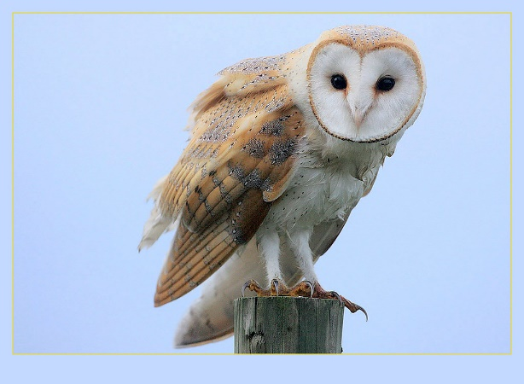
Welcome to KS1
Altrincham Church of England Primary School

Slide 3
Miss Baker –
Woodpecker Class – Year 1
Miss Stevens –
Owl Class – Year 2

Slide 4

Communication with you
@owlsACE
@woodpeckersACE
Letters will be going home seeking permission for photos to be shared on social media and the school website.

Slide 5

Communication with you

Slide 6
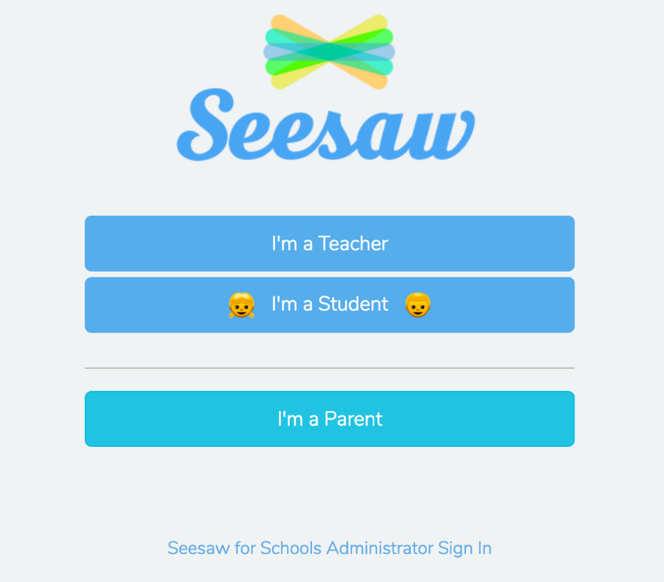
Communication with you

Slide 7
Safeguarding
Please line up outside the classroom at 8:50am; the children need to bring their reading book bag and a named water bottle
Children wear PE kits on day they have PE – Wednesday and Thursday
Due to the safeguarding of all children the classroom door will be closed at 9:00 and late comers will need to report to the school office
The KS1 day ends at 3:20pm, children will only be allowed to go to their adult collecting when we have made eye contact.
If somebody else is collecting your child please inform the class teacher that morning, phone or email the school office so that your child can be handed over safely - all staff will follow this safeguarding policy.

Slide 8

Behaviour
Key Stage 1 Behaviour Policy
(sunshine, rainbow and clouds)
All children begin the school day on the sunshine. If a child has to be reminded more than once about their behaviour, their name will move to the white cloud. A subsequent reminder will mean a move to the grey cloud. Every time their name is moved to the grey cloud they will miss 5 minutes of golden time.

Slide 9

Rewards
Golden Time
Every Friday the children will have up to 30 minutes of golden time at the end of the day. There will be a range of activities across all three classrooms for them to choose from weekly.
Superstar Assembly
On Fridays we have a superstar assembly to celebrate the children’s achievements. Examples of this include excellent effort, producing a great piece of work and outstanding behaviour. Certificates will be awarded to two children per week.
Wow postcard
Every week a postcard will be sent home sharing something special that has happened in school. This will be awarded to one child per week.

Slide 10
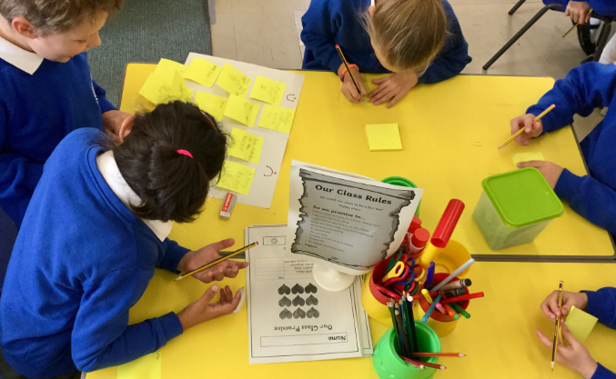
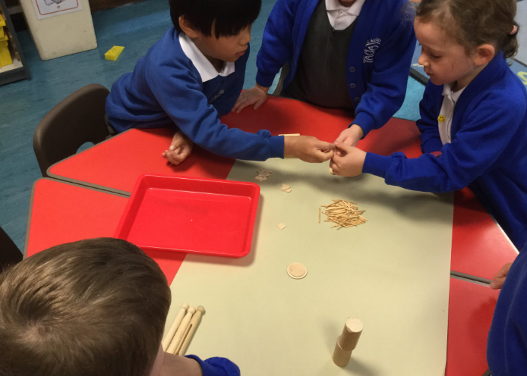
Attendance
Our whole school attendance goal is at least 95%.
Please support us by not booking holidays in term time.

Slide 11

Cashless School
We are now a cashless school. This means that all trips, milk money, school fund etc. need to be paid via ParentPay.

Slide 12

Uniform
All uniform needs to be named so that it can find its way back to you should it get lost
Please make sure that your child wears comfortable black school shoes with their uniform and not trainers
Children wear their PE kit on PE days. Please ensure if your child is unable to tie shoe laces that Velcro fastenings are used. No jewellery on PE days please.

Slide 13

Home Learning
Reading books are changed weekly, your child will pick up to 3 home reading books.
Children also have the opportunity to access the Bug Club online reading books.
Please make sure you use the reading record book to create a log of all the books your child has read.
Home learning tasks will be set on seesaw. If you prefer a hard copy can be sent home, this will need to be photographed and uploaded to Seesaw in order to be marked.

Slide 14
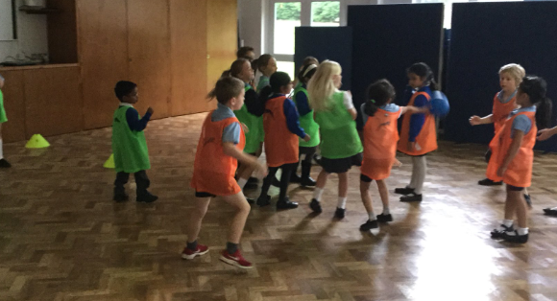
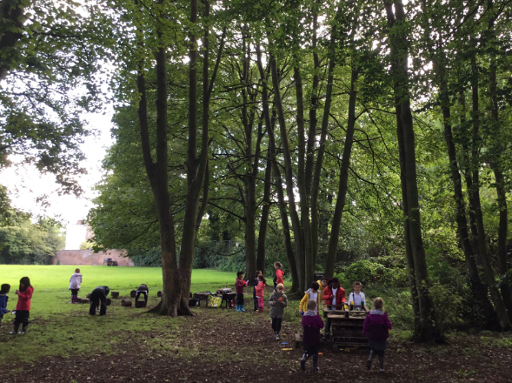

“C.O.A.L”
Creative, Outdoor and Adventurous Learning
Wednesday Afternoon.

