Slide 1


READING FRAMEWORK @ ACE
January 2023
Our approach to teaching Early Reading and Phonics
Altrincham Church of England Primary School

Slide 2

Content
National Curriculum for English by year group
Fully compliant DfE guidance
Decoding and phonological development “Phonics First”
Consistency across EYFS and Key Stage 1 (and beyond)
Fidelity to our accredited scheme : Phonics Bug
Fostering a love of reading built on “sticky knowledge”, deep understanding and confidence

Slide 3
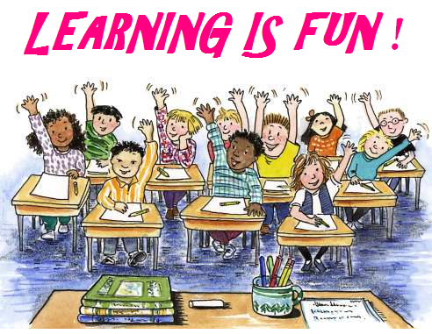
When is reading taught in school?
READING IS THE MASTER SKILL AT ACE.
In EYFS and Key Stage 1, Book Club takes place every day.
While children are learning to decode efficiently and successfully they are taught reading for an hour each day (EYFS and Year 1 and on a bespoke basis in Year 2 to address children’s learning needs).
This includes direct teaching of phonics for 30 minutes at the beginning of each day, and the opportunity to apply that learning to reading a text from or fully aligned to the Phonics Bug scheme.

Slide 4
When is reading taught in school?
Additional phonics teaching and reading practice takes place at other times throughout the day, including work on our quality key texts in English lessons, whole class reading, book-sharing and Phonics Bug follow up activities.
This is in line with DfE guidance:
development of reading, through a programme of
Systematic, Synthetic Phonics (SSP), should be taught
for 60 minutes per day.

Slide 5
When is reading taught in school?
Reading continues to be focused in English lessons, through our quality key texts, and in other activities eg reading a class novel.
It is important to note that not all children will learn at the same pace – many factors can affect full acquisition of reading fluency.
When children are not deemed fully fluent in decoding at the end of Year 1, they do not pass the Phonics Screen, which is a statutory test taken by all Year 1 children across England and Wales.
These children continue to receive explicit phonics teaching every day, in addition to Book Club lessons.

Slide 6
When is reading taught in school?
When children have learned all of the gpc (grapheme-phoneme correspondence) that enables them to decode quickly and smoothly, they have attained fluency.
The National Curriculum, and our Phonics Bug programme, expects this to be completed by the end of Year 1.
In Year 2, the focus for learning to read moves to comprehension.
Children have a 30 minute, text based Book Club lesson every day.

Slide 7
When is reading taught at KS2?
We call our reading lessons “Book Club” and encourage the children to engage with books in a social way – Book Club lessons are often noisy! By discussing, comparing, evaluating and arguing about books, children become fully engaged with the texts and with the skills needed for both reading for pleasure and, crucially, academic reading (disciplinary literacy).
In Key Stage 2, Book Club takes place weekly, for an hour (twice weekly during Spring term Year 6).

Slide 8
When is reading taught at KS2?
Lessons are based around novels, non-fiction texts and poetry, sometimes using extracts and sometimes focusing a whole text over a period of half a term or more.
If and when teachers judge it to be appropriate, children might be grouped within class or across the phase, based on teacher assessment and test data, to ensure that skills are taught thoroughly at an appropriate pace.
The children also have regular, timetabled opportunities for quiet, independent reading and for listening to high quality fiction and non-fiction being read aloud.
As children progress through KS2, opportunities to focus specific, disciplinary reading skills are planned within each foundation subject.

Slide 9
So what can I expect to see at home?
Children will bring books home to read with you, both in “hard copy” and electronic formats.
The books that they read themselves, independently, will be “fully decodable” as the children progress through the units of learning in our Phonics Bug programme.
These books will be in electronic format, using your log in to the Phonics Bug scheme.

Slide 10
So what can I expect to see at home?
As Synthetic Phonics are taught in a carefully planned, systematic way, children learn the gpc and blending skills within each unit; they apply these successfully to be able to read real books, by themselves.
The text in these books is, necessarily, simple. However, the content and presentation of the books are engaging and invite discussion.
The e-books have “read aloud” features which demonstrate clearly how each sound should be articulated – parents and carers frequently ask us about this and it is absolutely vital that phonemes are pronounced consistently correctly.
Children will also bring home a book for you to read aloud and share with your child, fostering that all-important love of literature and habit of reading for enjoyment, curiosity and relaxation.

Slide 11
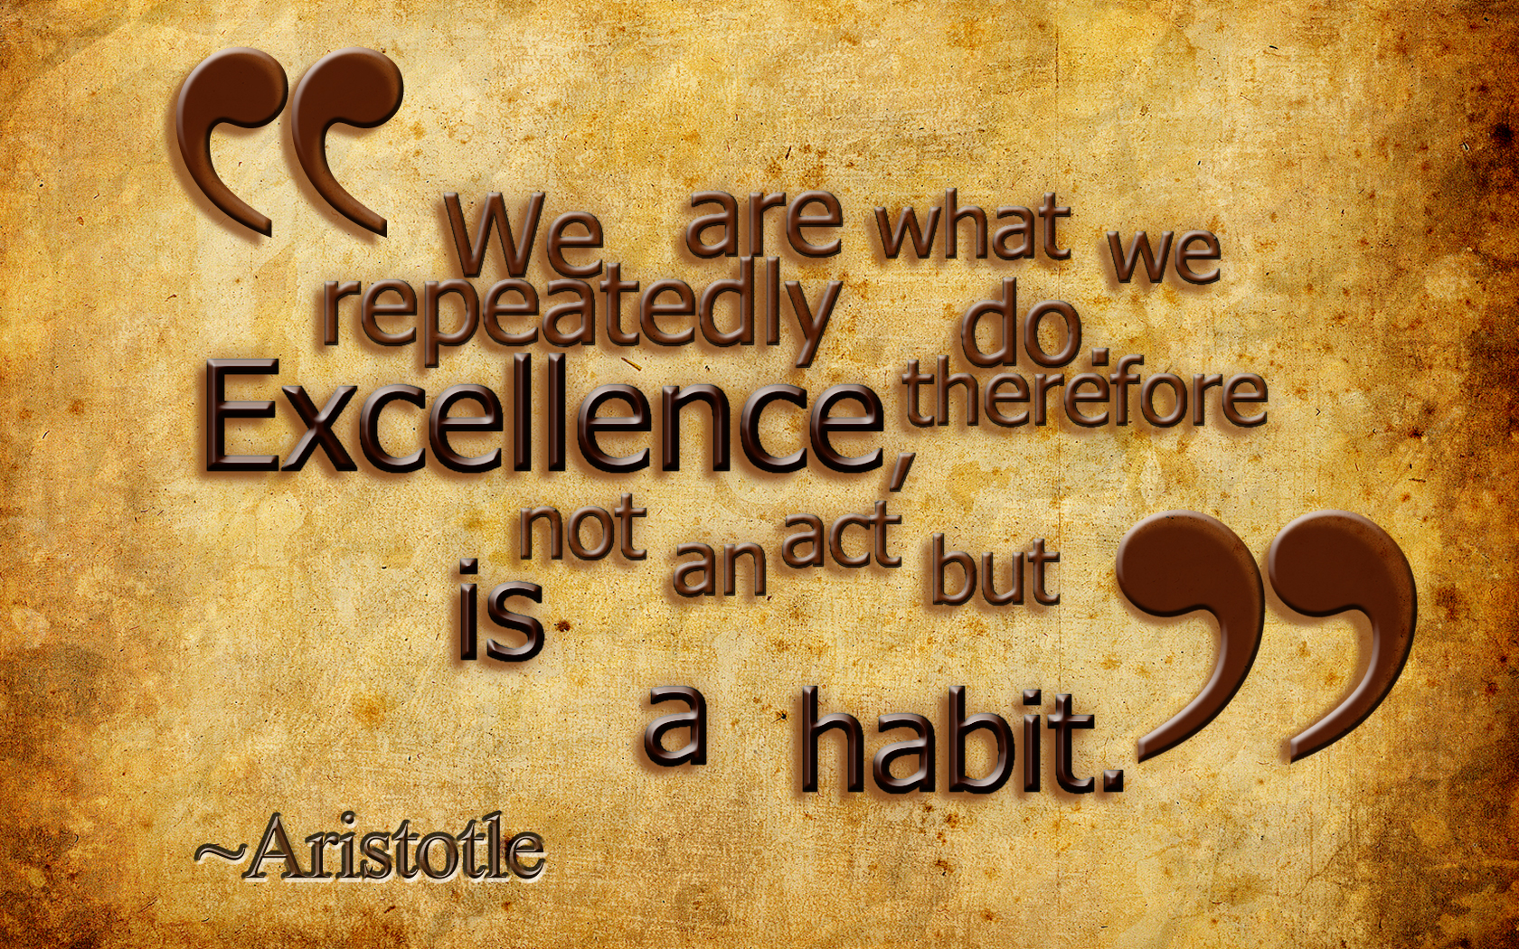
Why can’t my child go “faster”?
Correct pronunciation, full mastery of gpc and the ability to blend sounds effectively in familiar and unfamiliar words is the bedrock of success in reading.
“Pseudo” or “nonsense” words account for 50% of the score in the Phonics Screen.
We have a research-lead, outward facing curriculum development.
Compliance with DfE guidance

Slide 12
But this book is so easy, can’t my child have a harder book?
“I wish commentators would make it clear that phonics is a body of knowledge we all need. No maths teacher would dream of expecting children to remember numbers as strings of digits – they teach the concept of place value. In the same way, children need to understand that letters represent sounds.” (Letter from Mary Kelly in the Times Educational Supplement, 10 June 2011)
“When children are at the initial stage of mastering decoding, it is vital that they practise their decoding through the use of reading books which are consistent with their phonic knowledge. A child who has yet to study the digraph ‘ph’ should not be asked to read a book about an ‘elephant’ – they are likely to find this confusing and frustrating. Schools should, however, find separate opportunities to build children’s vocabulary and enjoyment of literature by reading to them throughout their time in school” (DfE Reading: The Next Steps)
“Overall, we can conclude that a synthetic phonics programme, as a part of the reading curriculum, has a major and long lasting effect on children’s reading and spelling attainment. Indeed, these skills were found to be increasing many years after the end of the programme. It is evident that the children have learnt a technique that they can use for themselves, that they have learnt a self teaching technique.” Clackmannanshire Study
“Teaching phonics is more effective on average than other approaches to early reading …, though it should be emphasised that effective phonics techniques are usually embedded in a rich literacy environment for early readers and are only one part of a successful literacy strategy.” EEF
Short answer: NO!
The DfE guidance is very clear – their research indicates that where children’s books are not matched, in the early stages, to the SSP teaching taking place in school, progress is impeded.
Whilst children might have excellent gpc, or they might read intuitively well, grasping gist, it is crucial that all the building blocks are put in place securely in the early stages of learning to read. The skill of blending effectively and efficiently must be fully embedded.
Longer answer: We are always here to talk to you about your child’s progress. Your insight and input are vital, and we will listen to your views and be responsive to them. We will explain our rationale for the books your child is being given to read and be rigorous in our monitoring, including taking account of parental feedback.

Slide 13
Reading Cities and our library
When children are competent and secure in their knowledge and application of GPC , having completed each of the 30 units in the Phonics Bug scheme, the requirement for books to be “fully decodable” reaches a natural conclusion…at this stage, children can synthetically decode the vast majority of words that they will meet in texts.
At this stage, our reading scheme moves from Phonics Bug Units to our “Reading Cities”. These group books by readability, looking at a broader spectrum of reading demands beyond phonics and decoding.
Reading Cities take the children all the way through to Year 6.

Slide 14
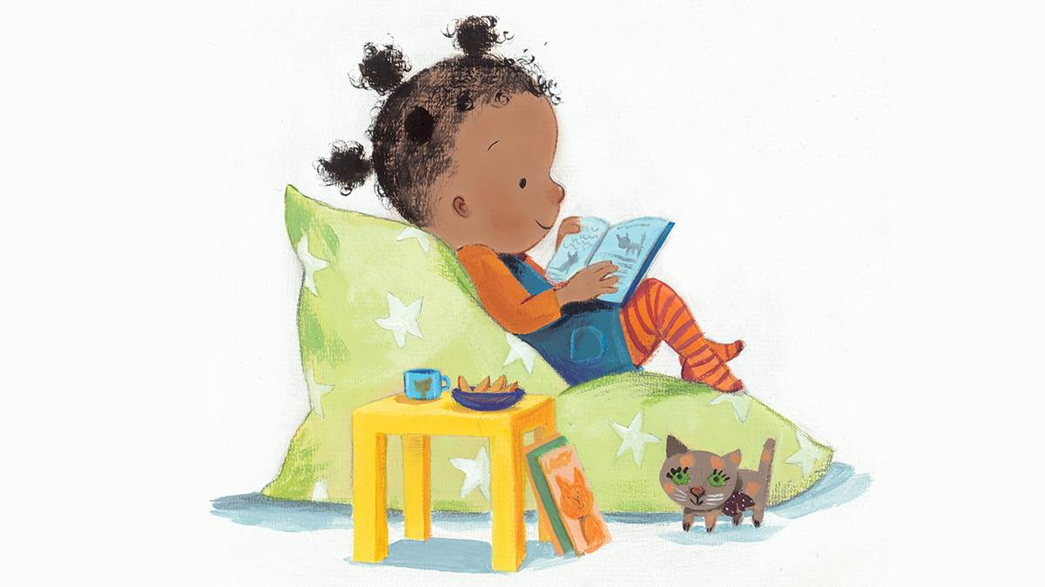
Thank you for your time…any questions?

