Slide 1


PHONICS SCREENING CHECK
INFORMATION FOR PARENTS 2023
Altrincham Church of England Primary School

Slide 2
DATES
MONDAY 12TH – FRIDAY 16TH JUNE
Tests will take place throughout the week, during the mornings

Slide 3
What will happen?
Children are tested on a 1:1 basis, by their class teacher or a teacher who is well known to them
They read words aloud from a booklet
There is a practice page to familiarise and make sure the child is comfortable and confident
No prompts are given, but the process is gentle and supportive
The teacher keeps a tick list as the child reads – all words are ticked, so there is no off-putting crosses!
The child does not see the list or know their score

Slide 4
What does the booklet look like?
There are forty words to read
They are set out clearly, four words to a page
Some words are real and some are “pseudo-words”, also known as “nonsense” or “alien” words
The non-words have a picture of an alien beside them, so the child knows that will not “make sense”

Slide 5
What is the format of the check?
There is no time limit
Children read through each page, word by word
They are allowed to sound out, but they must say the whole word with no “gaps” in order to be marked correct
Teachers have a form to tick – either the correct or incorrect column
A total out of forty is noted at the end of the check
This is reported to parents as meeting or not meeting the standard, along with the actual score, with your child’s annual report in July

Slide 6
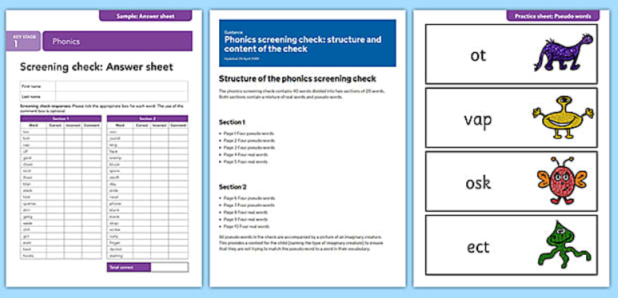
So, what do they look like?

Slide 7
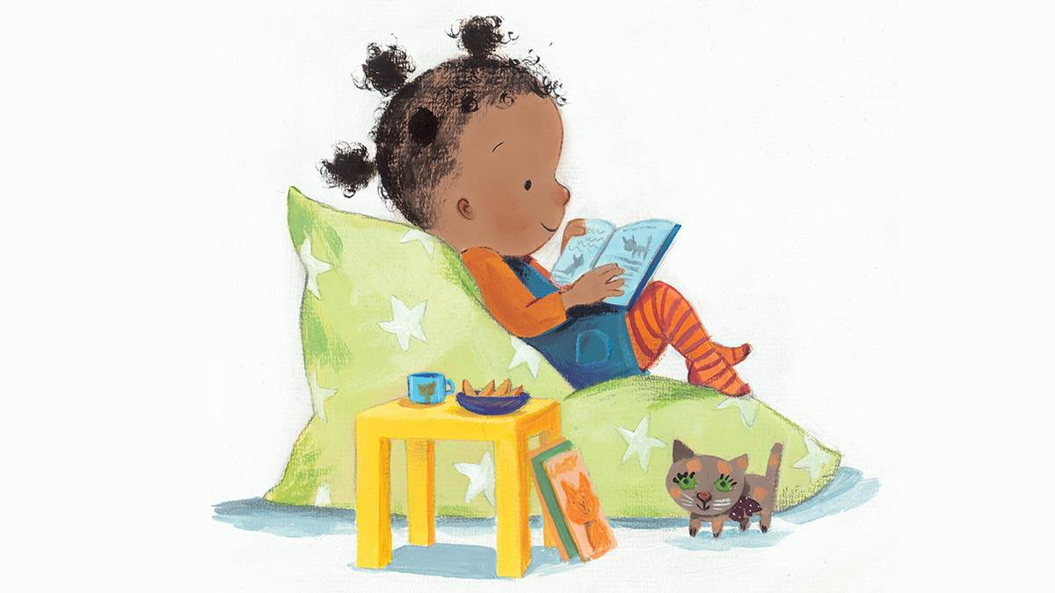
Thank you for your time…any questions?

