Slide 2

What is air pollution?

Slide 3

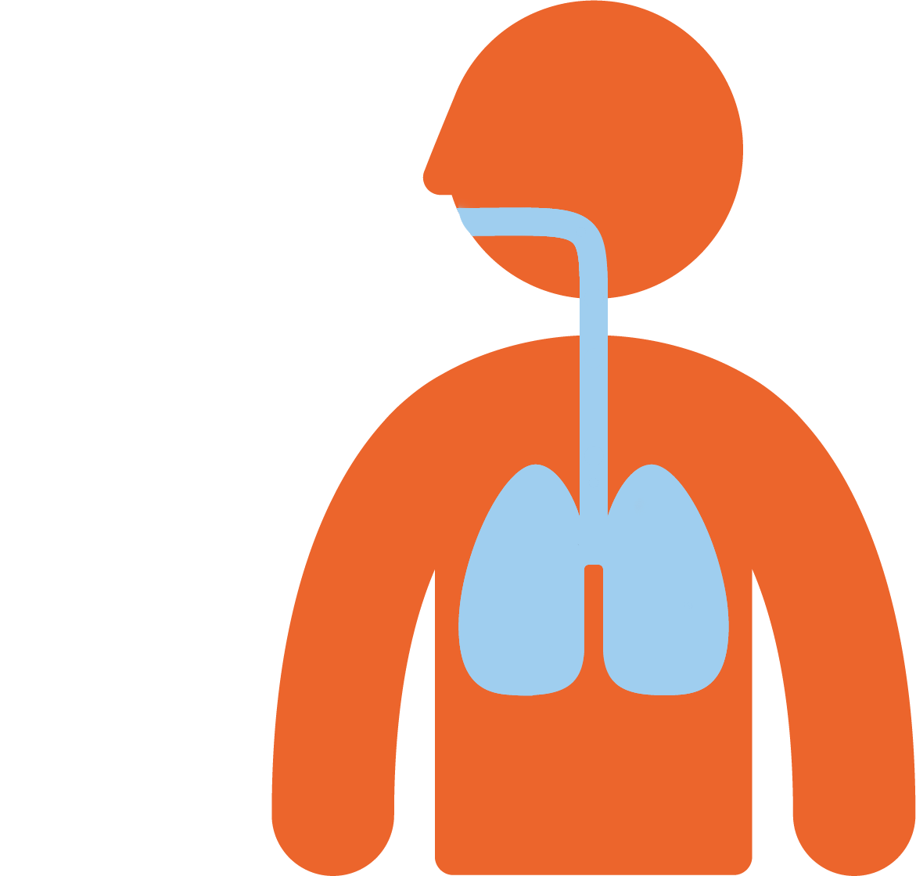
Air pollution is in the air that we breathe in.
The particles and gases enter our bodies and can damage our health.

Slide 4

Any amount of pollution can be damaging to our health, but the more that you are exposed to, the bigger the risk and the larger the impact it can have.

Slide 5










Where does air pollution come from?

Slide 6
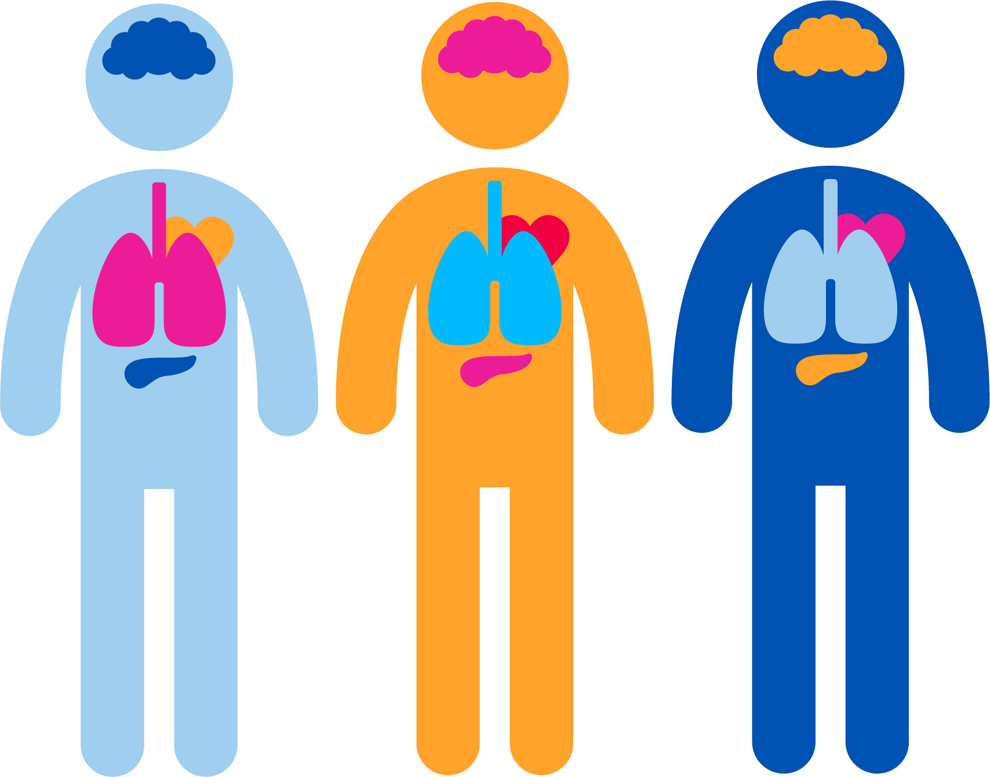
How does air pollution affect us?
Air pollution can damage your lungs and impact your breathing.
Exposure to air pollution can cause asthma, or make symptoms of asthma worse.
Breathing air pollution can impact your heart and cause future heart problems.
But we can fix it!

Slide 7



Source | Head
Health effect | Shoulders
Solution | Knees

Slide 8
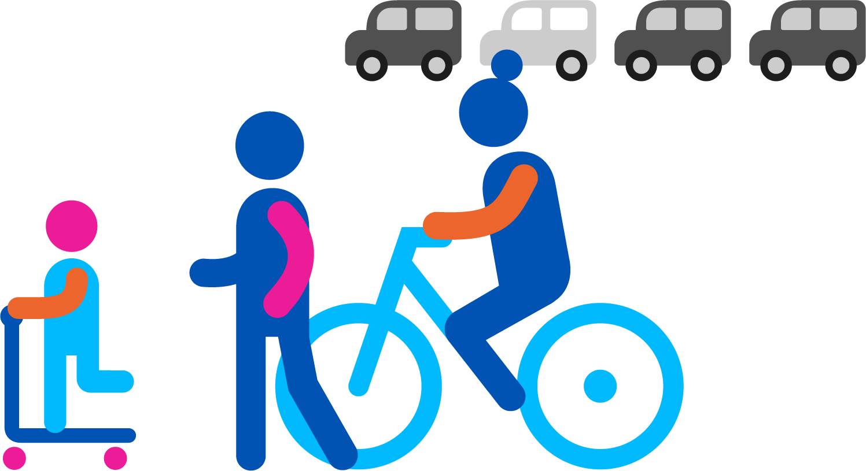
Cars

Slide 9
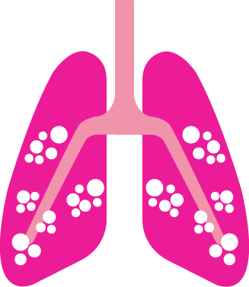
Making asthma symptoms worse

Slide 10

Avoid heavy traffic

Slide 11

Burning wood and coal at home

Slide 12

Vans

Slide 13
Cycling or walking

Slide 14

Impact heart and lead to future heart problems

Slide 15
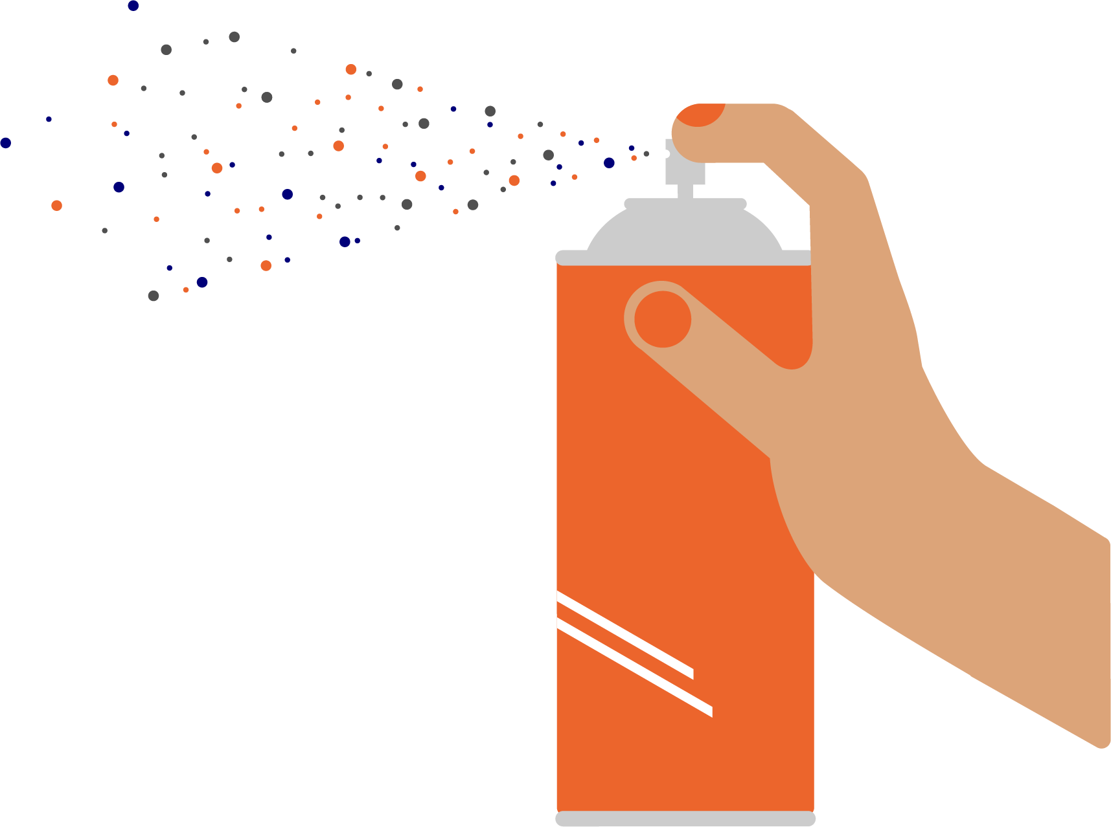
Strong smelling sprays and toiletries
Notes:
e.g. spray deoderant

Slide 16

Open windows when cooking and cleaning

Slide 17

Walk instead of driving

Slide 18

Electric car

Slide 19

Leaving the engine running

Slide 20

Strong smelling cleaning products

Slide 21

More coughing

Slide 22
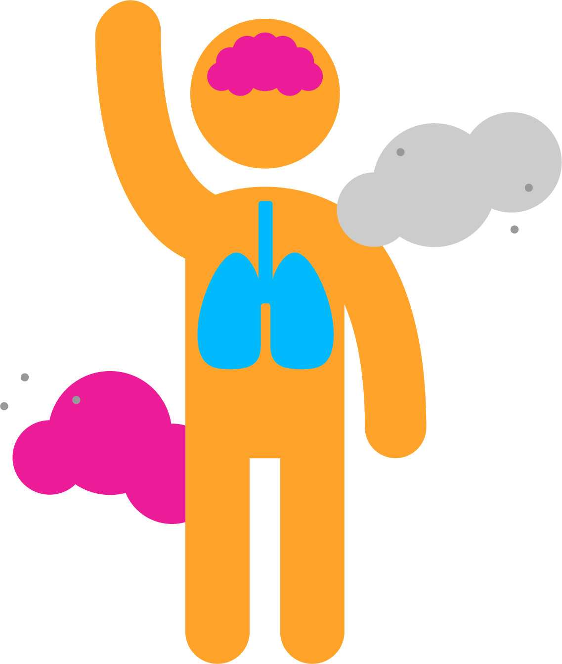
Damage lungs and impact breathing

Slide 23


Take quiet routes and avoid main roads

Slide 24




So what can you and your family do to play your part?
Outdoor air pollution
Walk, cycle, scoot or take public transport whenever you can instead of driving
Discover the side streets – use quieter streets and avoid main roads
Go electric – ask your parents to think about making their next car an electric one!
Don’t idle – ask your parents to turn off their engines when the car isn’t moving

Slide 25



Indoor air pollution
Open windows to let the fresh air in – especially when
  cooking
  or cleaning
Use fragrance-free milder cleaning products.
Ask your parents to only burn dry, well-seasoned wood or smokeless fuel on your stove, open fire or barbeque.

