Slide 2
What does connecting with others mean to you?

Slide 3
Who have you already connected with today?
How did you connect?

Slide 4
Together by Matt Goodfellow
Watch this video: https://youtu.be/bOsbofgusak.
Poet Matt Goodfellow reads his poem 'Together' as part of Children's Mental Health Week 2023. This poem is taken from the book 'The Same Inside', published by Macmillan.

Slide 5
Malala Yousafzai
Anne Frank
Greta Thunberg
Louis Braille
Jazz Jenning

Slide 7
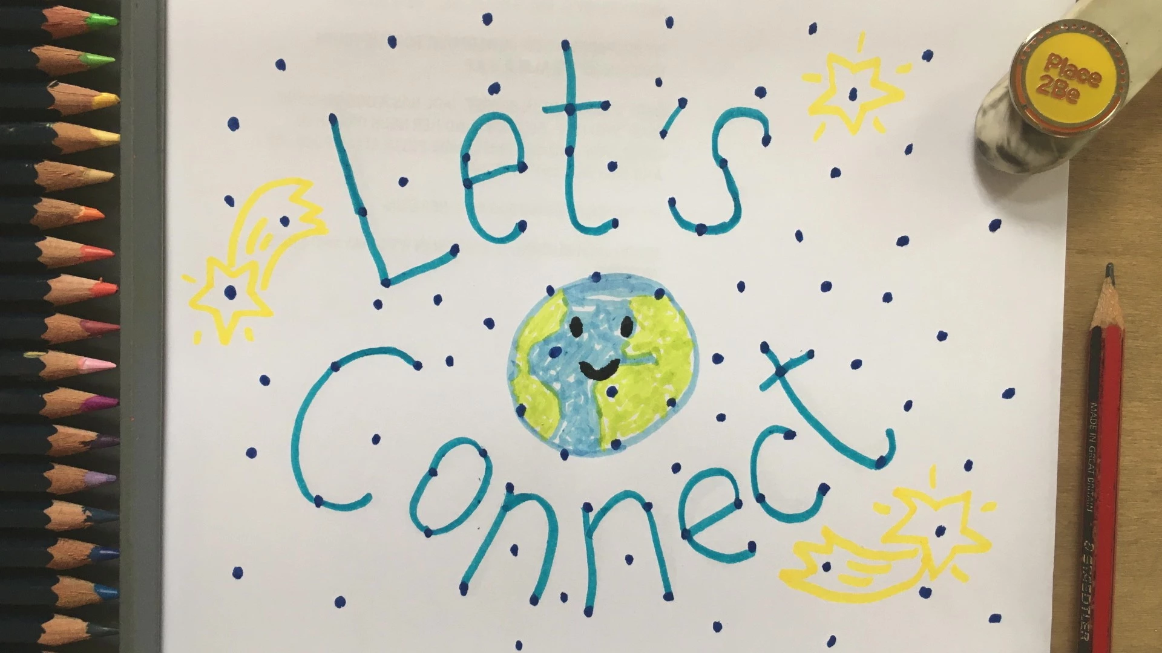
Let’s finish with a final prayer
Dear God,
You created us and you love us.
You care about how we are feeling and you love it when we tell you.
Thank you for the special people in our lives who help us to look after our bodies and minds.
Help us to find joy in connecting with other people this week.
Amen.

