Slide 1


Phonics Workshop
for Parents

Slide 2

Outcomes
In this workshop you will:
understand what phonics is
understand how we use Bug Club Phonics to teach early reading and spelling
become confident in supporting your child at home

Slide 3
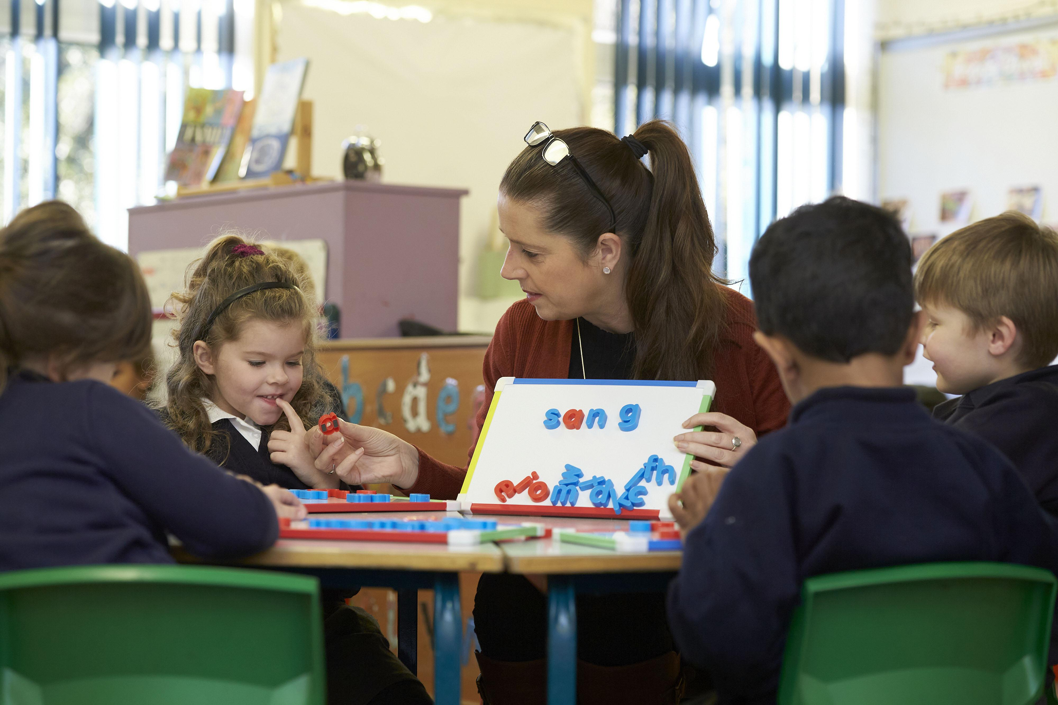
What is Phonics?
Systematic method for teaching children to read and spell.
Learning the sounds (phonemes) that make up the English language.
Learning to use these sounds to read and spell words.
Understanding that there are different ways to represent these sounds using letters (graphemes) eg – e, ee, ea, ie, y

Slide 4
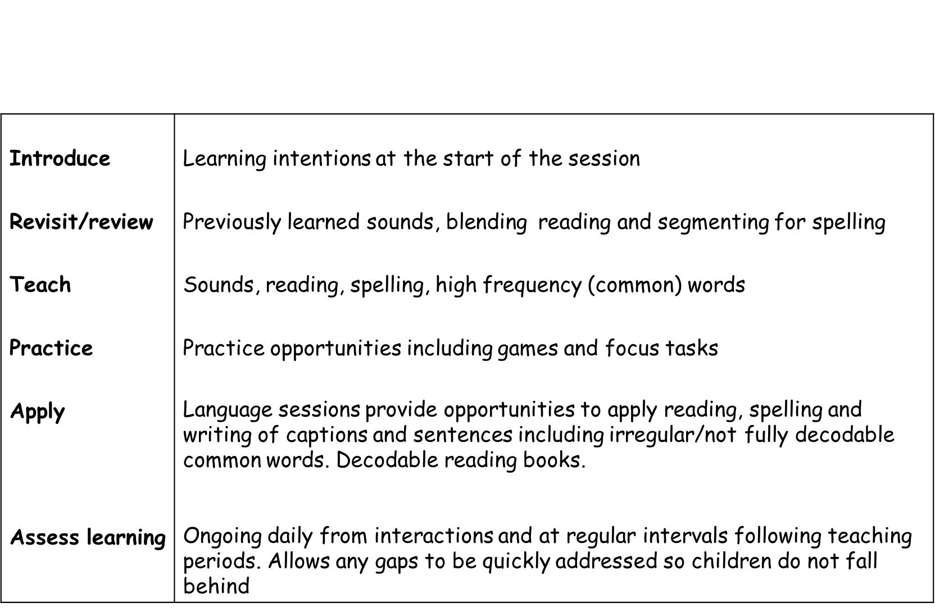
How we teach phonics at ACE
Bug Club Scheme
Reception and Year 1
Some Year 2s
Daily 40 minute phonics lesson
Fluid groups to meet each individual child’s needs
1-1 Interventions
Reading books and sounds to bring home

Slide 5
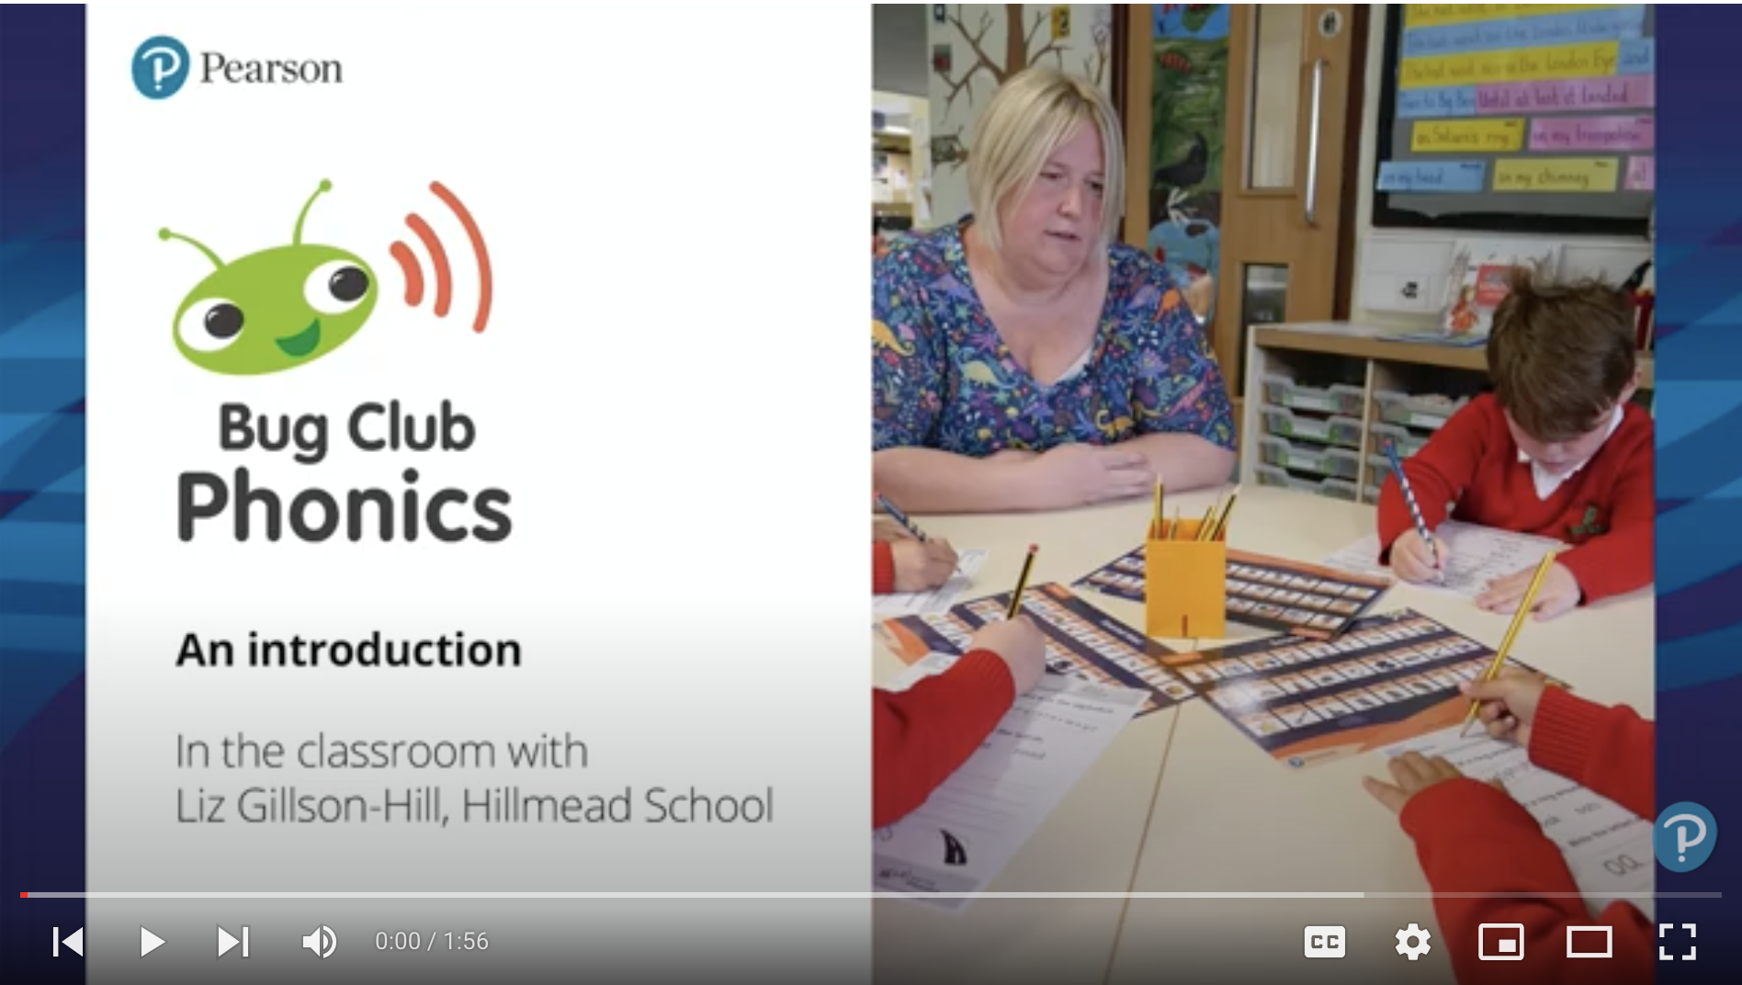

What does Bug Club look like in school?

Slide 6
Definitions
Phoneme – The smallest unit of sound in a word. For example, the word cat has three phonemes: /c/ /a/ /t/
Grapheme – The written letter or group of letters that represent a phoneme (sound). For example, s, sh and igh are all graphemes.
*A phoneme is what we hear; a grapheme is what we see.
Digraph – Two letters that work together to make one sound. For example, sh in ship or ai in rain.
Trigraph – Three letters that work together to make one sound. For example, igh in night.

Slide 7
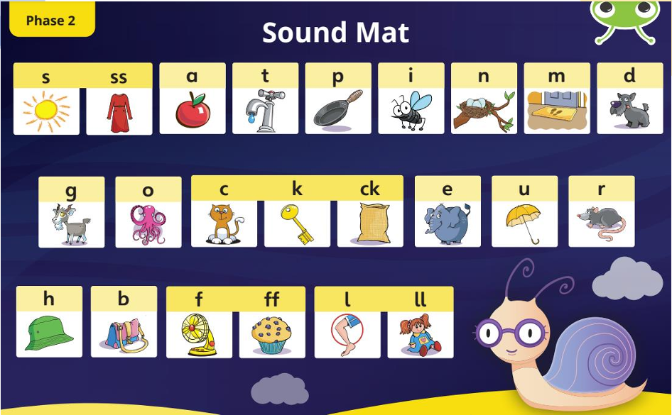
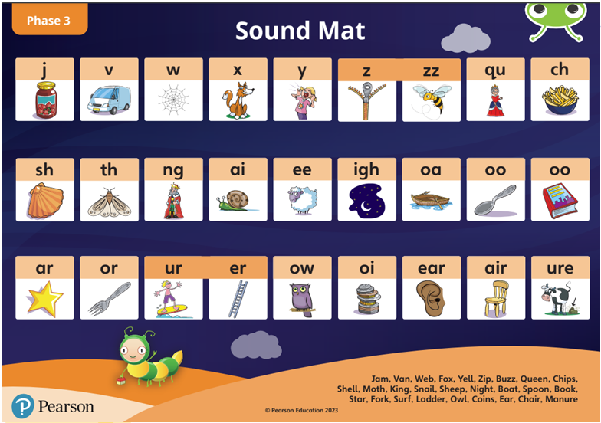
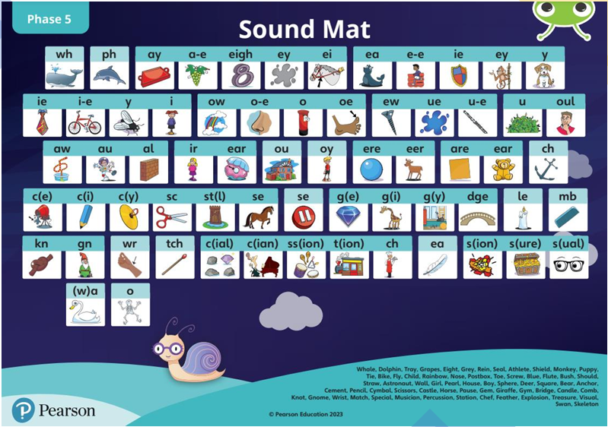
Phonics Bug Progression

Slide 8
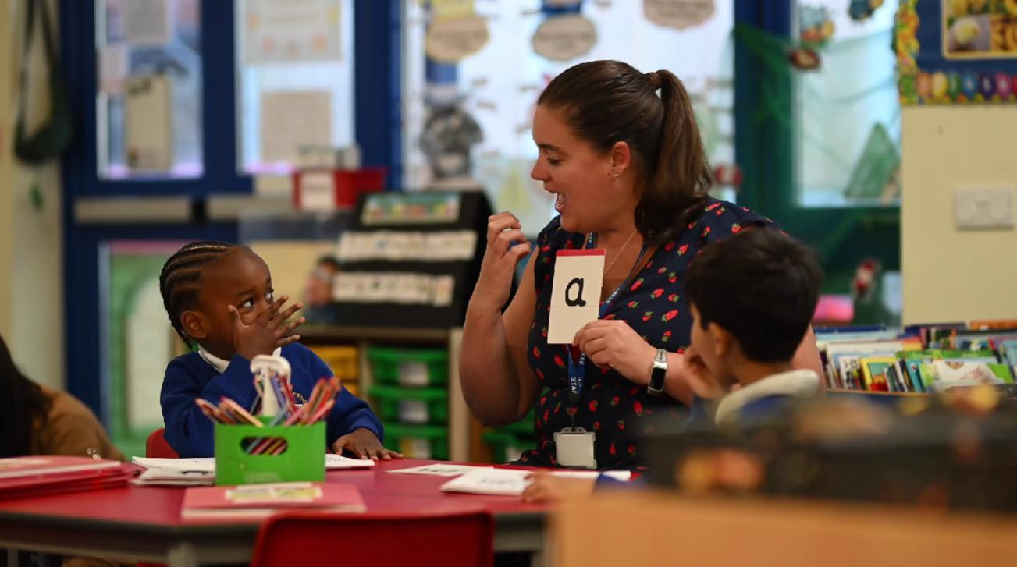
Pure sounds
m not “muh”
s not “suh”
t not “tuh”

Slide 9
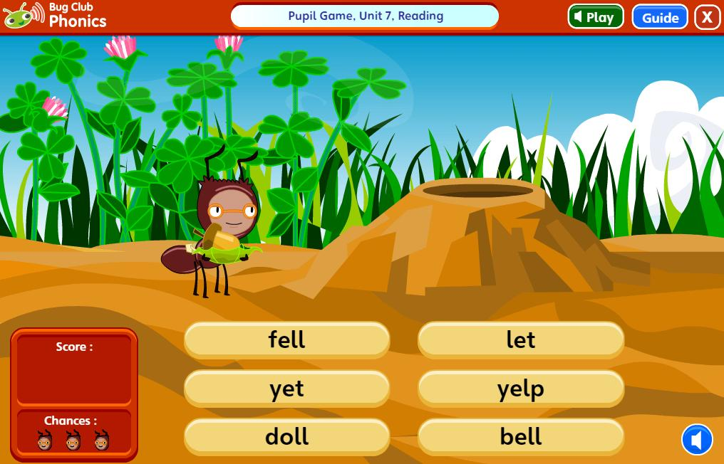
Blending for reading
c-a-t → cat
sh-i-p → ship
f-r-o-g → frog

Slide 10
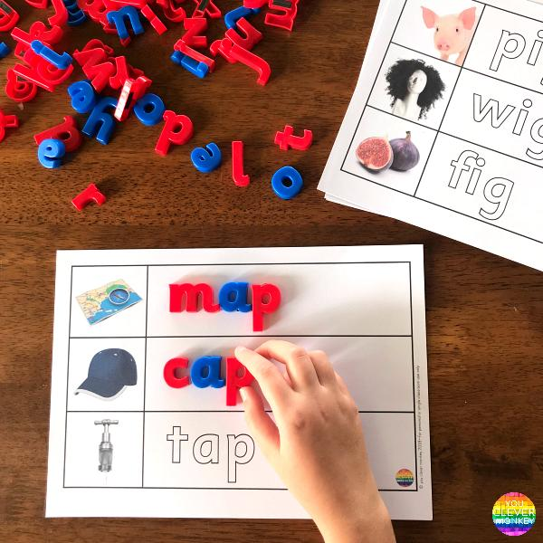
Segmenting for writing
To spell "ship" children think:
sh-i-p

Slide 11
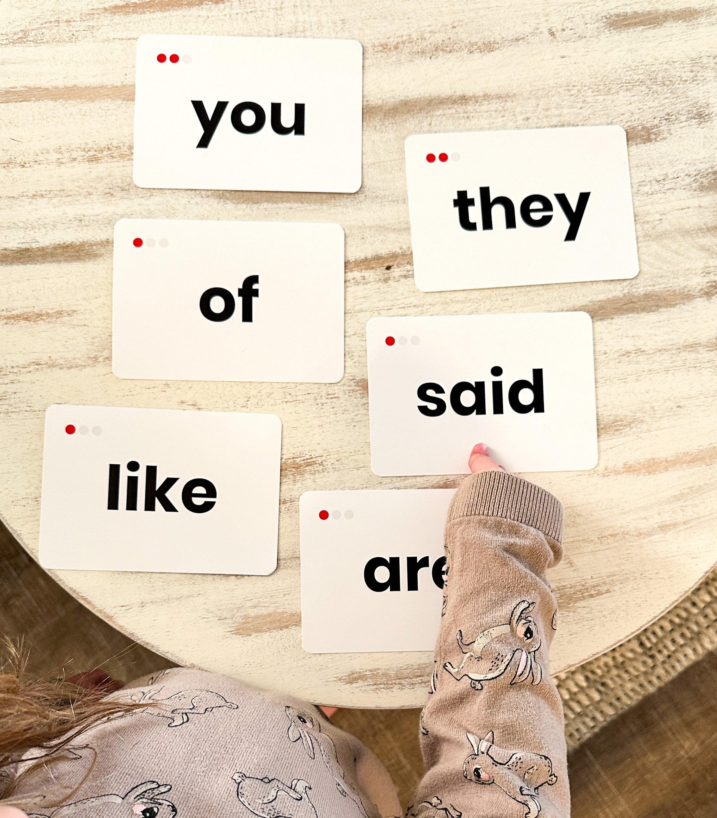
Tricky Words
Children are also taught to read and spell ‘tricky words ’ which are words with spellings that are irregular or ‘tricky’.
For example - he, she, was, the, I

Slide 12




Reading Books
Reading Practice Books
Fully decodable
Matched to phonics knowledge
Sharing Books
Adult reads with child
Focus on enjoyment and language

Slide 13
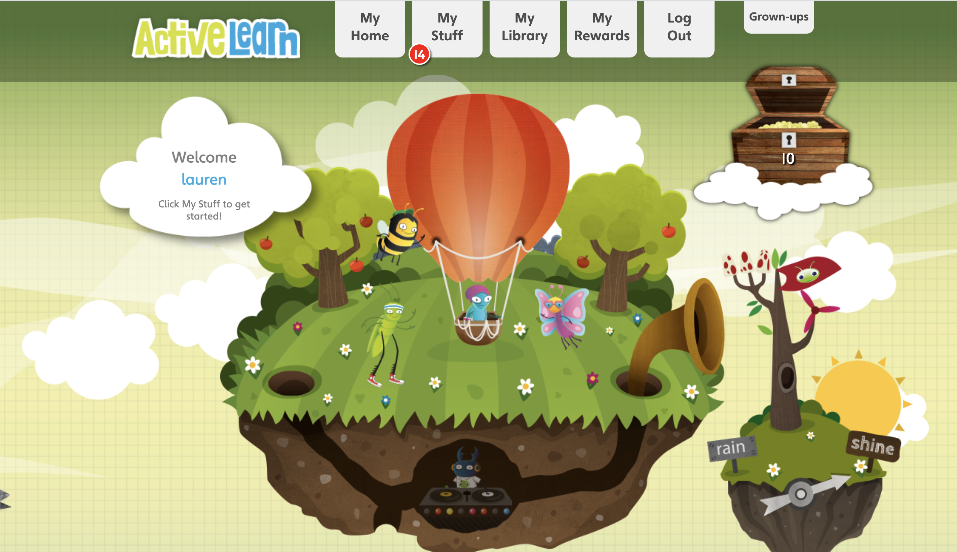
Pupil World – Online books and games
www.activelearnprimary.co.uk

Slide 14

Supporting reading at home
Every Day
✅ Read for 5-10 minutes
✅ Practise sounds
✅ Talk about stories
✅ Praise effort
✅ Re-read familiar books

Slide 15

Any questions

